Slide 1
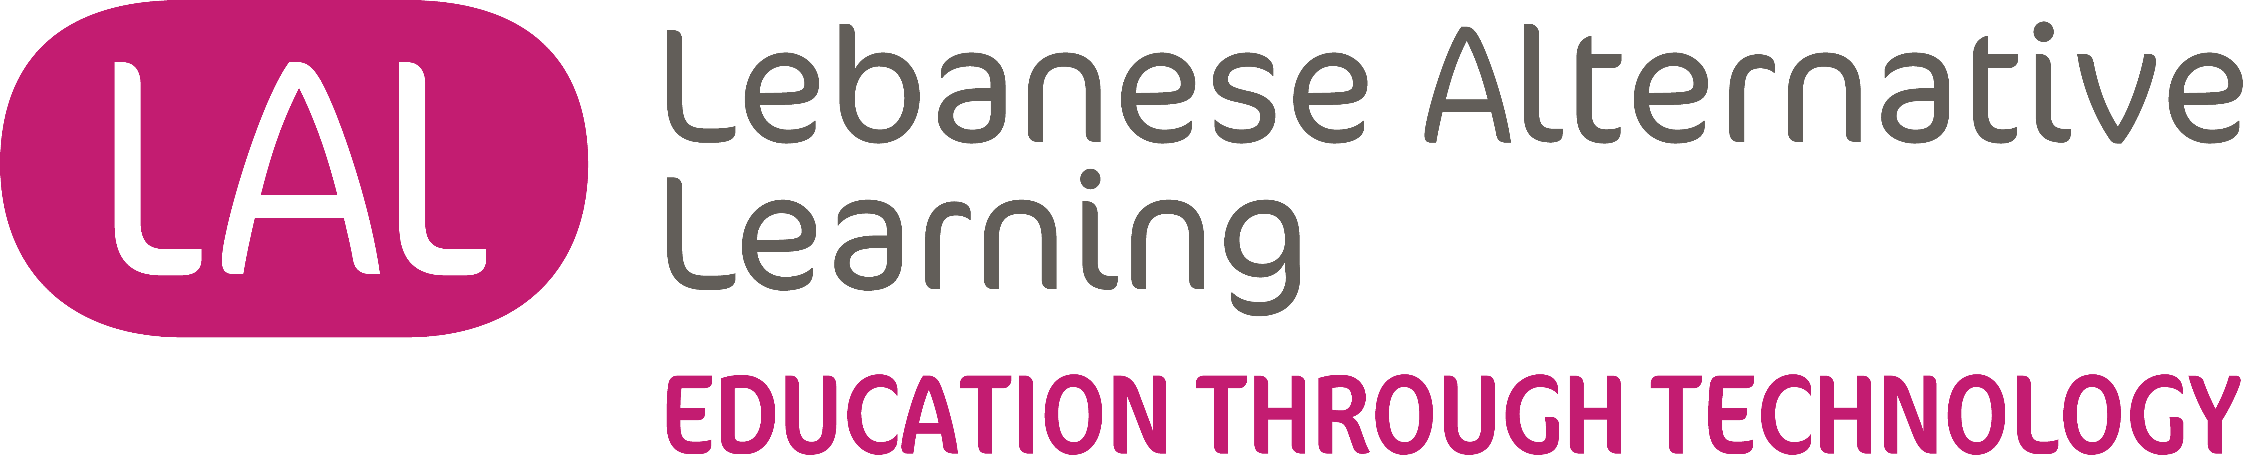

2025
Annual
Report
THE ADAPTIVE YEAR

Slide 2
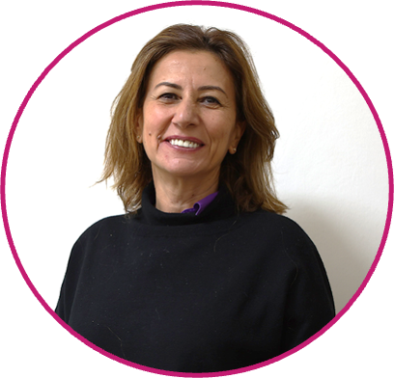
EDITORI-LAL
“It is not the strongest of the species that survives, nor the most intelligent, but the one most responsive to change.” Charles Darwin
This year, we learned another important lesson from our presence on the ground. The field taught us adaptability. While strong pedagogical theories guide our work, the real challenge lies in understanding whether the context is ready to apply them as designed. True transformation happens when teachers are not asked to fit predefined models, but are engaged as partners, guiding us through constraints, realities, and opportunities on the ground.
This year also reinforced the importance of collaboration, co-creation, and shared leadership. We learned that meaningful and sustainable change rarely comes from working alone, but from building ecosystems where listening, learning, and adapting together become central to the process.
If this year brought its share of challenges, it also brought moments of deep purpose and collective strength. Above all, I would like to pay tribute to the exceptional LAL team. They were present in the field, working alongside teachers and students across the country while continuing to develop high-quality content on our flagship platforms, “Tabshoura”, and “Lalmoudaress” and innovative solutions to teach and learn.
More importantly, they demonstrated humility and courage: the courage to listen, to question, and to adjust. They embraced the understanding that there is no perfect solution, only solutions that are realistic, relevant, and genuinely embraced by the communities we serve.
These lessons continue to shape who we are and how we work. They reaffirm our commitment to an education grounded in reality, driven by those on the front lines, and rooted in the belief that learning must remain possible, especially in times of crisis.
Nayla Fahed
Co-founder & Executive Director

Slide 3
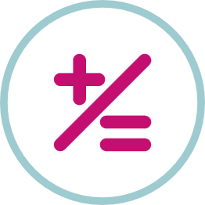
LAL in Numbers
1242
Units
Published
240
School
Reached
10
Alternative
Learning
Spaces
41
Partners’
NGOs
68 000
Platform Users
3000+
Teachers
Trained
537+
Devices Distributed

Slide 4

This Year in a Glimpse
After five years of partnership with Ana Aqra, and with the support of Theirworld, we concluded the digital part of My Best Start Early Childhood Education project, creating a full program reinforcing foundational skills for very young children. It is now published on the Tabshoura free-to-access digital learning platform. This project benefited also from a collaboration with Skild organization and the Center of Education Research and Development, CRDP.
In 2025, we significantly strengthened our advocacy efforts. As an outcome of completing the Influencing and Political Acumen Programme provided by the Asfari Foundation, we focused our advocacy strategy on elevating Teachers’ Voice to ensure their on-the-ground demands and realities are directly heard by education decision-makers. Through small movies, we honored the teachers’ creativity, and unwavering commitment to continued learning and innovation with very little means and in the most challenging circumstances. We launched a community of influential educators.
We also concluded the Tahawor project, implemented under Adyan’s Rashad Center for Cultural Governance (RCCG), which significantly reaffirmed the importance of dialogue and community engagement in education and public life.
We continued researching enhancing of our technologies, introducing AI to enhance processes, thanks to the continuous support of and collaboration with the Asfari Foundation.

Slide 5
This Year in a Glimpse
New chapters were opened this year. We began developing the EmpowerEd High School Curriculum with the support of Drosos Foundation and in collaboration with the CRDP.
We also launched the EdTech in Palestine project, in partnership with Kamkalima from Lebanon and AlNayzak from Palestine, with the support of AlFanar. This initiative involved adapting and transferring our content to create a dedicated digital platform for Palestinian students, “Yalla Nodrus”.
In parallel, we established Alternative Learning Spaces in 12 crisis-affected areas across Lebanon, where we had the privilege of working alongside extraordinary teachers. These spaces not only support educators but also enable students to reinforce their learning and address gaps through a Self-Directed Learning (SDL) approach, bringing our learner-centered pedagogy into the heart of communities. Their creation was made possible thanks to the generous support of Theirworld, Expertise France, and Education Above All.
In our early childhood education programs, we introduced well-being as a core component, thanks to the support of the Dalia and Ramzi Rishani Charitable Trust, marking the first steps toward a happiness curriculum that supports wellbeing and personal skills since a very early age.
By combining innovative pedagogy, technology, and teacher capacity building, these initiatives reinforce our broader mission: to make quality learning accessible, contextually relevant, and sustainable.

Slide 6
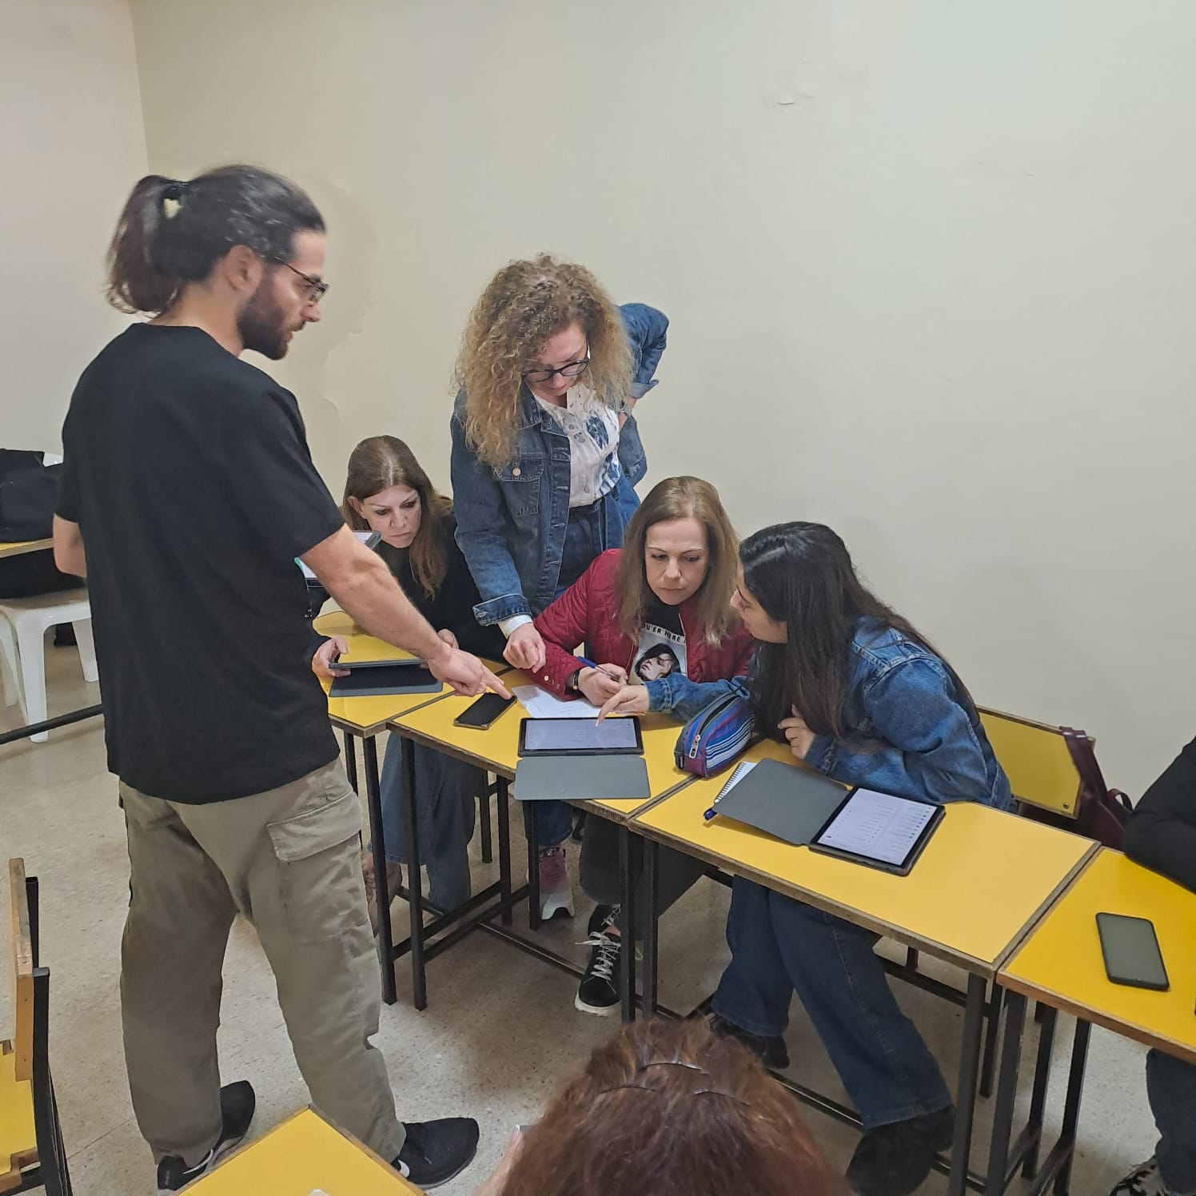
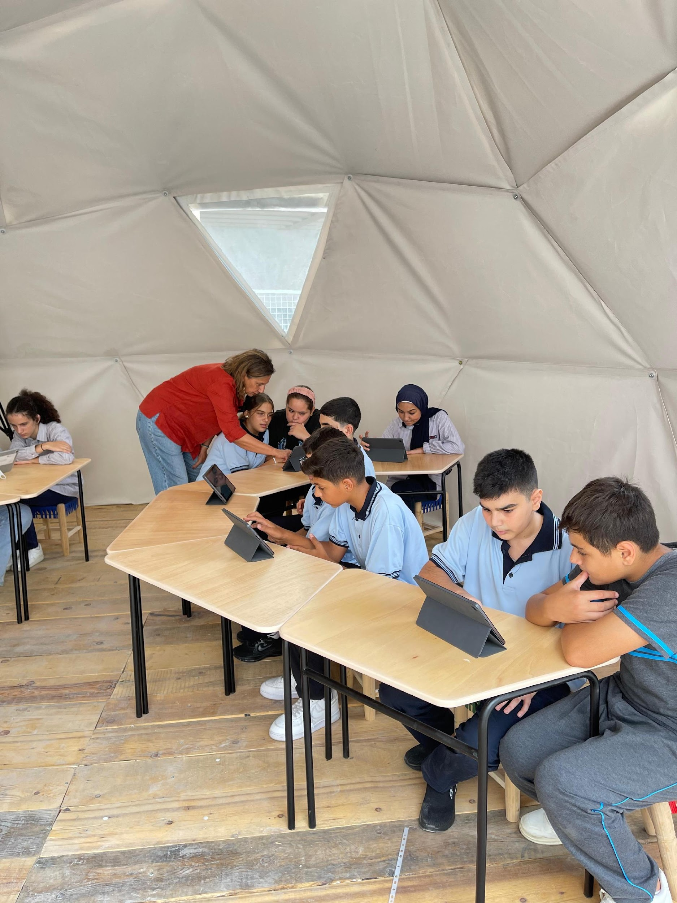
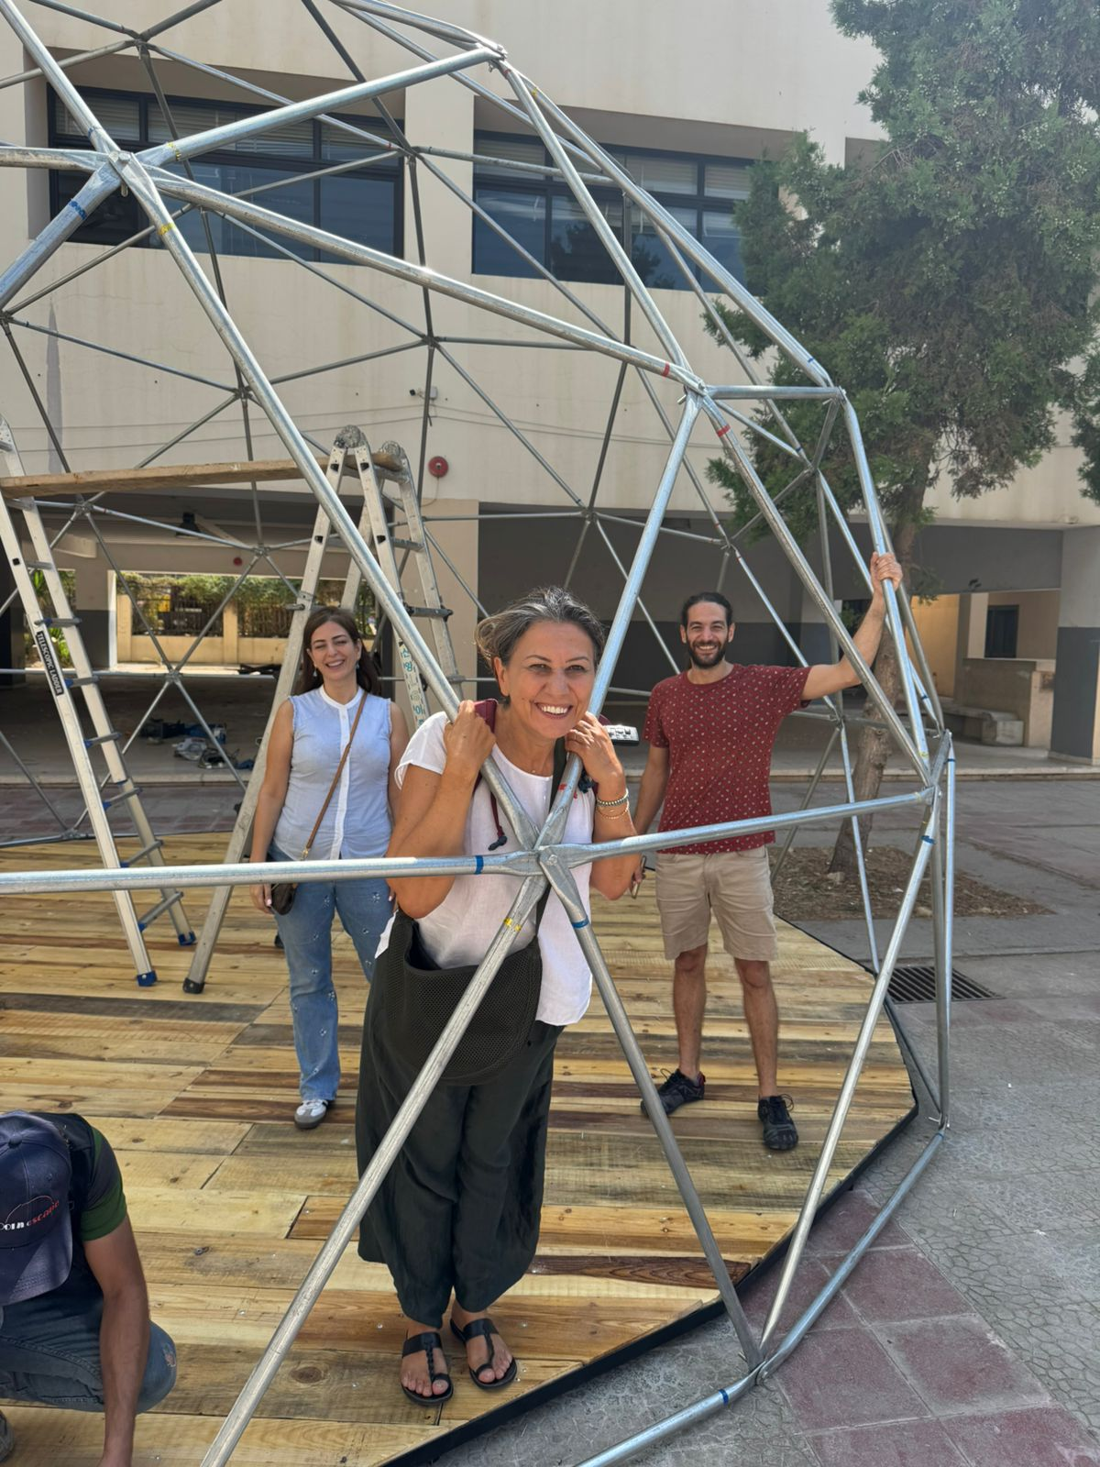
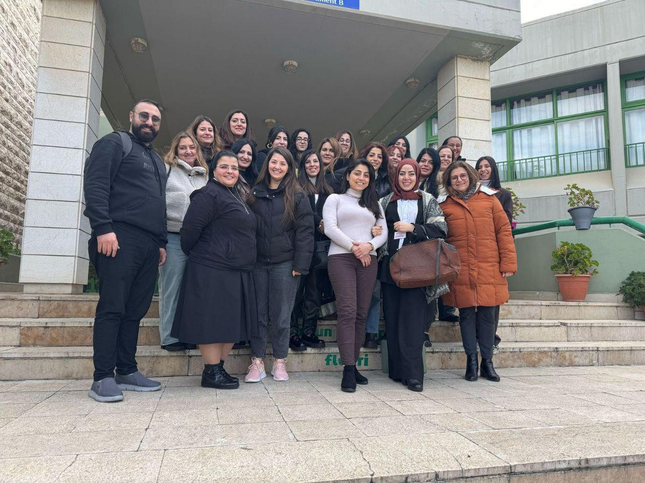
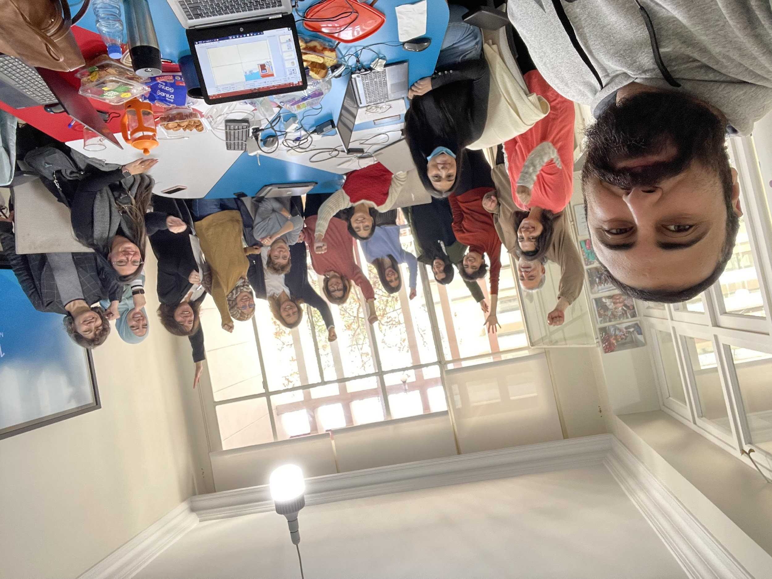
Team in Action

Slide 7


PROJECTS

Slide 8



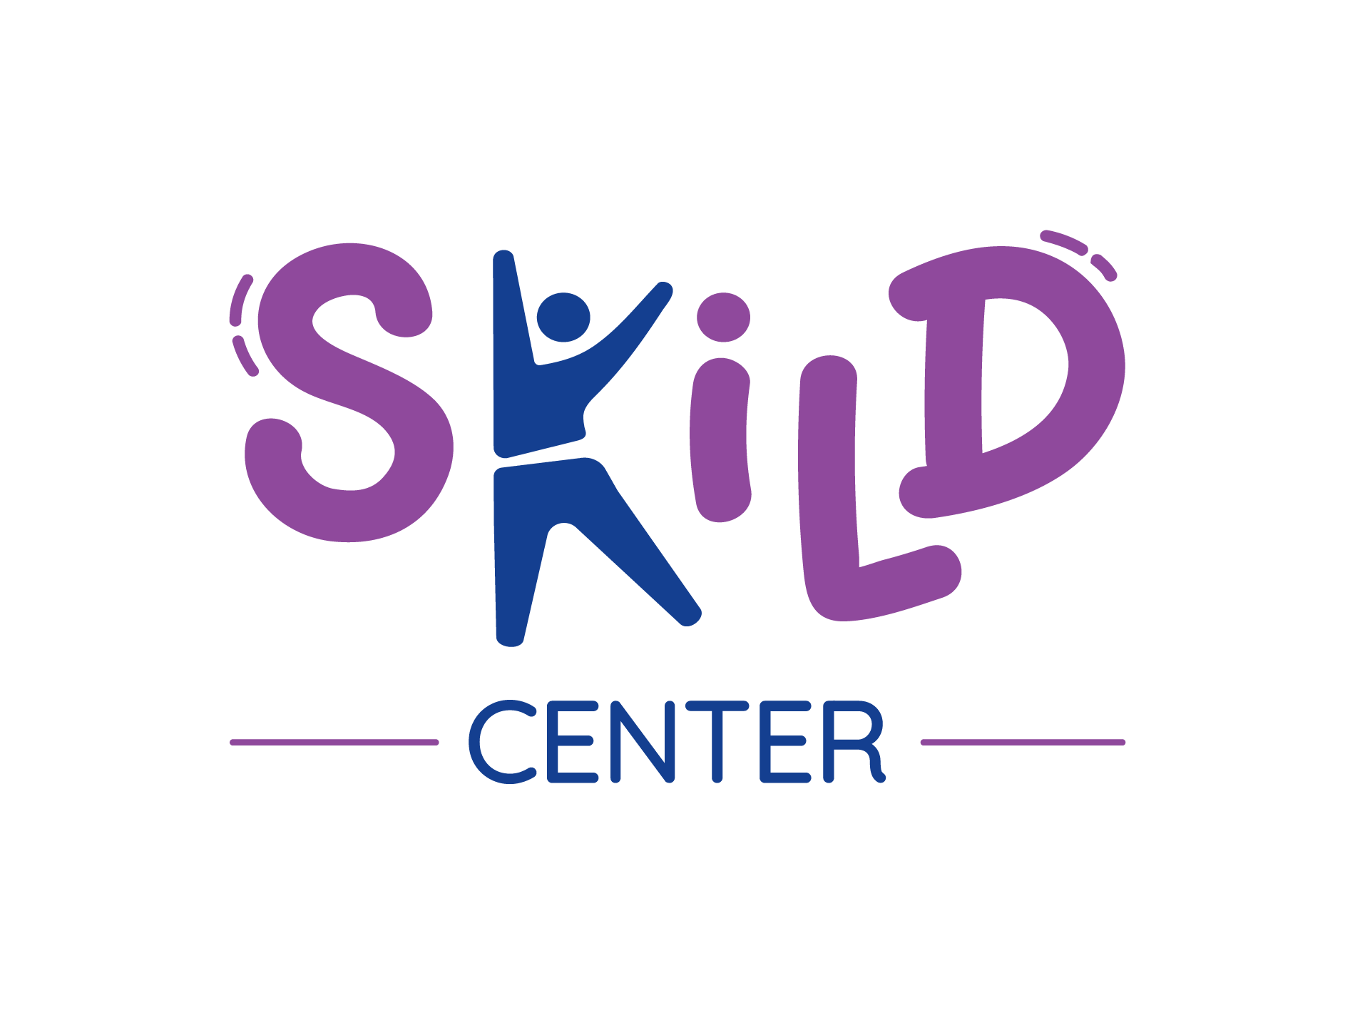
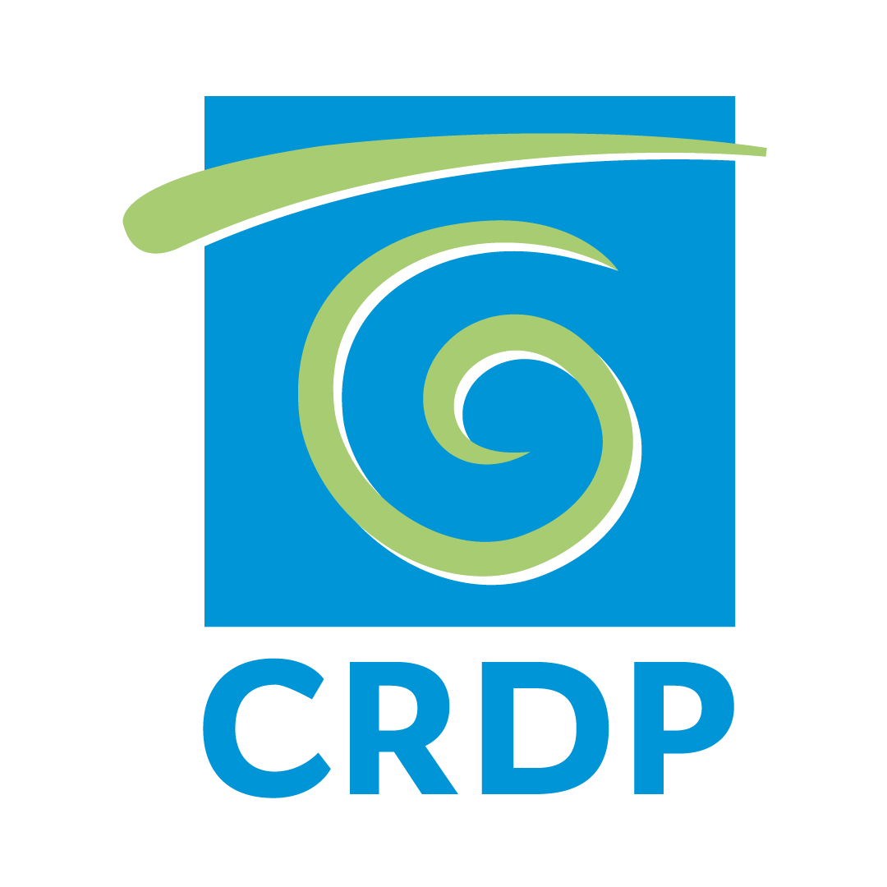

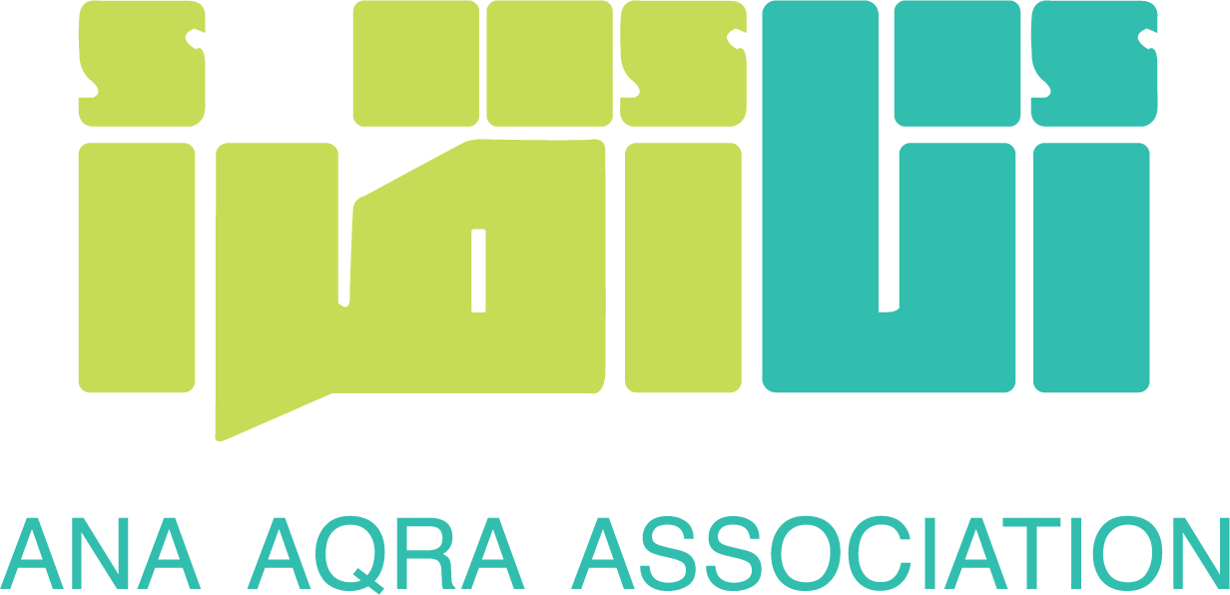
My Best Start
Target age groups: 3 to 6 years old
Program reach: 48 partner schools; 266 educators ; 2,552 learners
Supported by Their World
In partnership with Ana Aqra, Skild and CRDP
My Best Start (MBS) aims to develop and implement a comprehensive digital literacy program aligned with the Lebanese national curriculum, designed to enhance learning outcomes through high-quality digital interactive units.
The program empowers learners by fostering independent learning skills and digital competence, while simultaneously supporting educators with the tools, resources, and structured content.
The program reflects a successful partnership between LAL and the Ana Aqra Association, strengthened by and additional partnership with Skild, an organisation focused on inclusion and a close collaboration with the CRDP, which enabled the initiative to reach a national scale.
Central to the project is the development of 167 interactive, curriculum-based courses published on “Tabshoura” digital learning platform and transferred on Madristi UNICEF platform. These courses promote differentiated, student-centred learning pathways that allow learners to progress at their own pace, take ownership of their learning journey, and build critical digital and academic skills.
By integrating innovative pedagogy with curriculum alignment, the project strengthens both teaching and learning practices, ensuring sustainable and impactful digital education across schools.

Slide 9
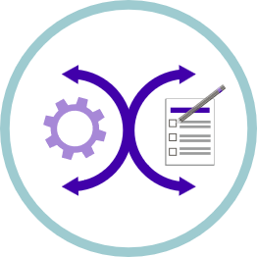

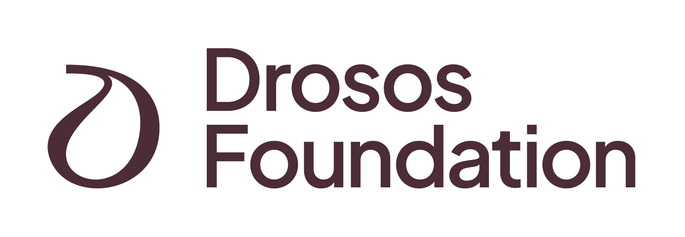
EmpowerEd Pathways
Target age groups: 15 to 18 years old
Pilot reach: 17 educators; 322 learners
Supported by Drosos Foundation
In partnership with CRDP
The Empowered Pathways project is a four-year initiative led by Lebanese Alternative Learning (LAL) and funded by the Drosos Foundation, in partnership with the Centre for Educational Research and Development (CRDP) of a high-quality section on Tabshoura, and design inclusive learning modules.
By combining LAL’s expertise in alternative and digital learning with CRDP’s national mandate in curriculum development and quality assurance, the project aligns closely with national education priorities while introducing innovative, learner-centered approaches tailored to Lebanon’s evolving educational landscape.
At its core, Empowered Pathways strengthens students’ learning outcomes and future readiness through the development of high-quality, inclusive learning modules. By integrating transversal competencies across subjects, the project equips both learners and educators with future-oriented skills and pilots scalable models that enhance the quality of education.

Slide 10
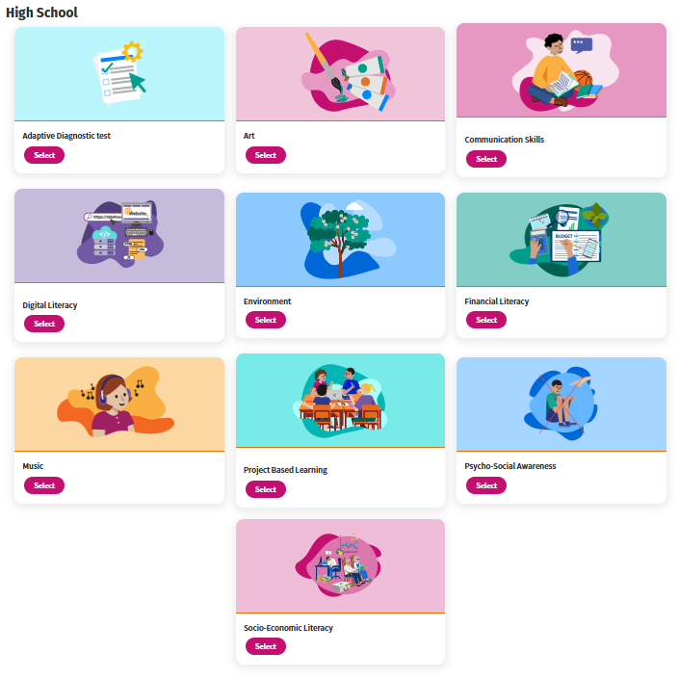

EmpowerEd Pathways
In 2025, the project further enriched high school learning by developing dynamic transversal activities focused on essential life, including communication skills, digital literacy, financial literacy, environmental awareness and Project Based Learning developed with teachers from our partner schools.
Through interactive, student-centered approaches, these initiatives empower learners to think critically, communicate confidently, and make informed decisions for their futures.

Slide 11



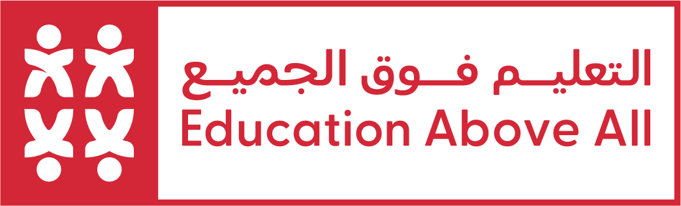



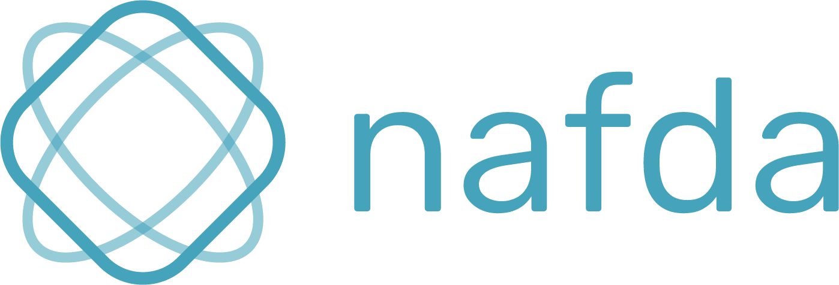

Alternative Learning Spaces (ALS)
Target age groups: 6 to 18 years old
Program reach: 12 spaces; 145 educators; 4,622 learners
Supported by Expertise France, Education Above All and Theirworld
In partnership with Thaki, Tree House, nafda
The ALS project creates safe and engaging learning environments across different regions of Lebanon, providing children and youth aged 6 to 18 with the support they need to continue learning despite challenging times and repetitive crisis that hit the education sector in Lebanon.
Through these spaces, students can reinforce their skills, fill learning gaps, and develop confidence, while educators receive the tools and training to deliver high-quality, student-centered instruction.
Seven of these spaces were established in public schools with the support of MEHE. We extend a special thank you to Ms. Sana Hammoud and the Directorate General office for their unwavering support.
Our goal is to establish a scalable model for nationwide expansion, offering flexible and inclusive learning opportunities for all students.

Slide 12
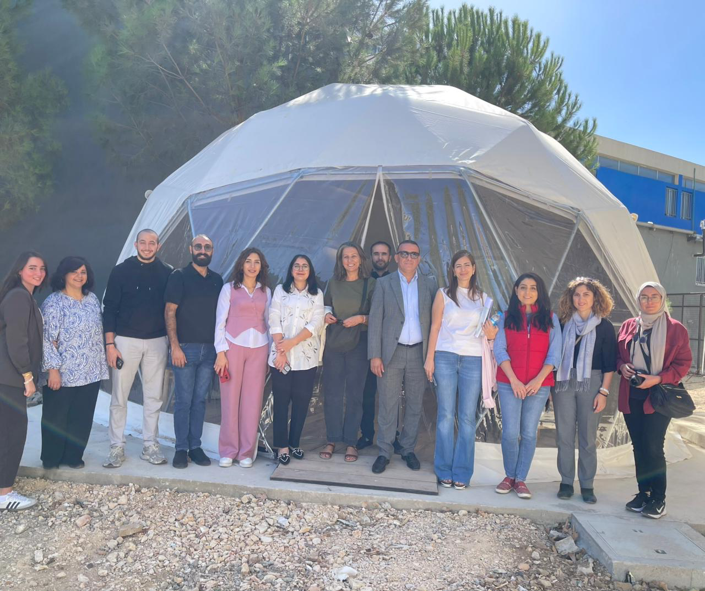
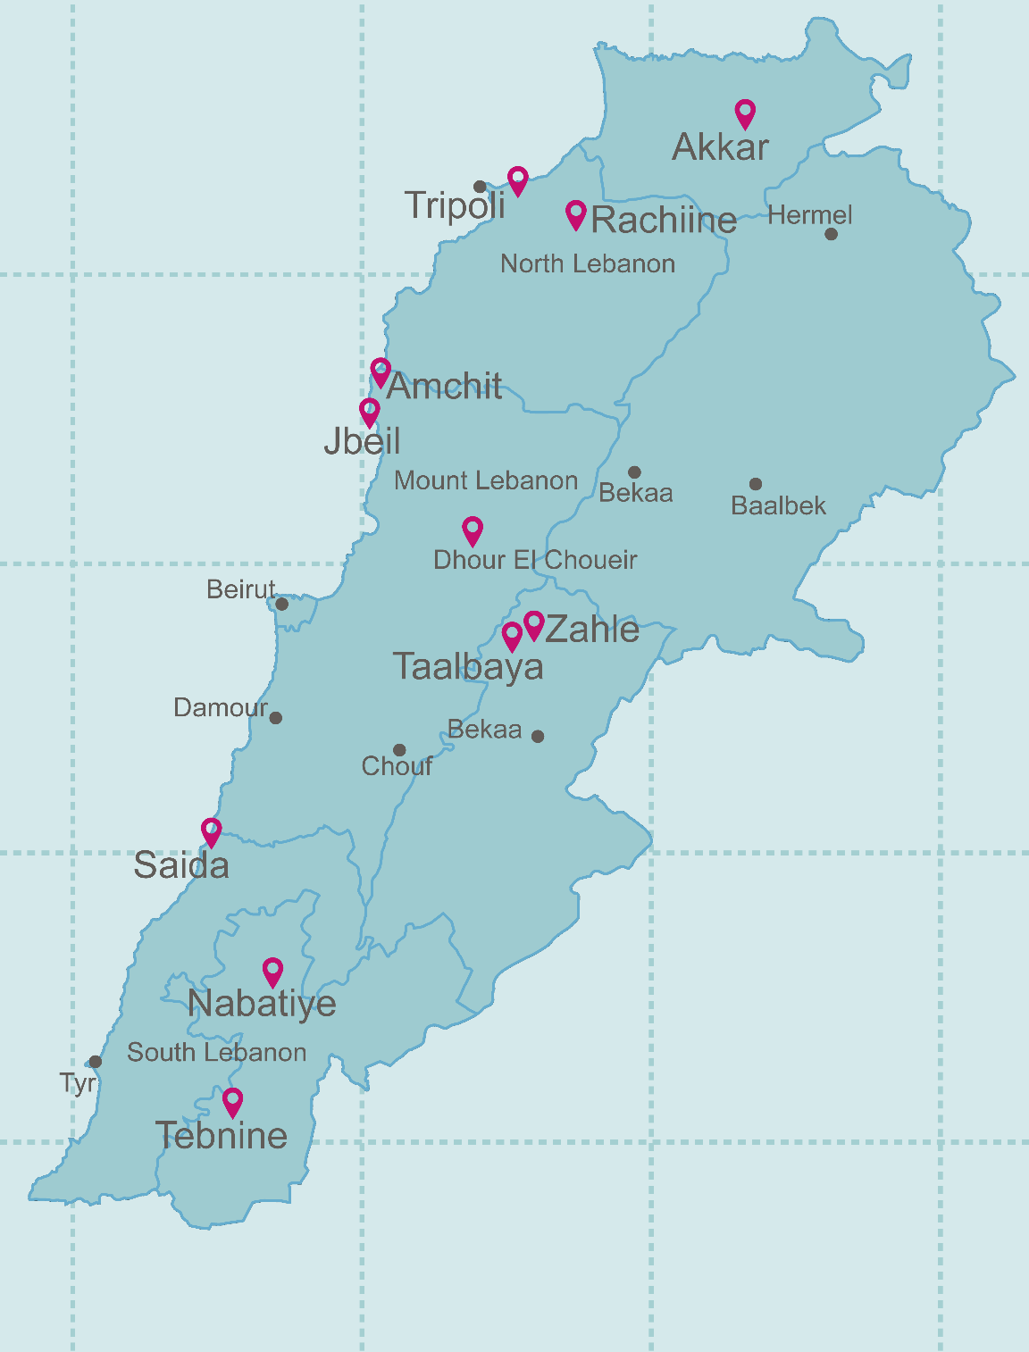
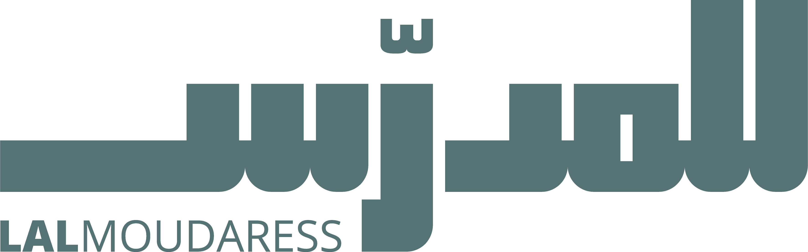
Alternative Learning Spaces (ALS)
To achieve this, we leverage our existing resources:
Tabshoura: Free digital learning platform aligned with the Lebanese curriculum, accessible online and offline via the Tabshoura App.
BeeKee-Tabshoura Boxes: Innovative offline servers bringing digital content to classrooms without internet access.
Lalmoudaress: Platform providing lesson plans and professional development for blended and self-directed learning.
IFERB (Internet-Free Education Resource Bank): Over 500 hands-on, project-based learning resources developed with support from Education Above All.
Thaki Laptops: Refurbished devices preloaded with learning content, including social-emotional stories to support children’s well-being.

Slide 13

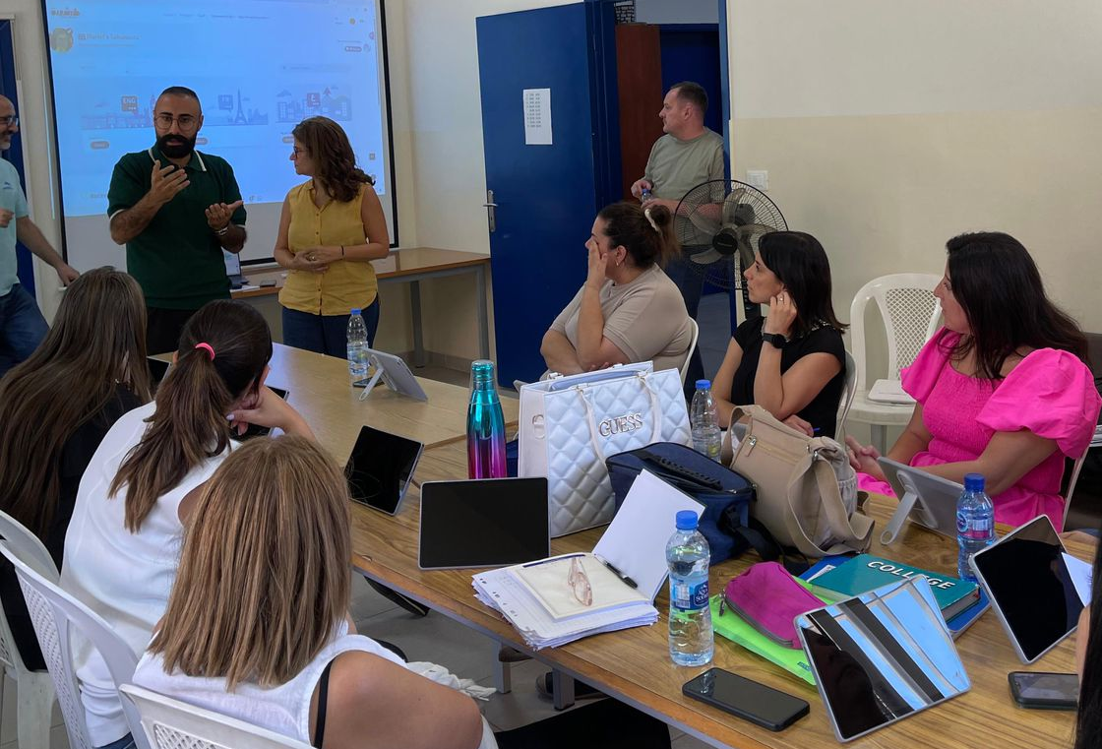
Teachers’ Voices
Lalmoudaress Community of Influential Educators
Number of participants: 40+ teachers
“I finally feel that my voice matters beyond my own students. The community recognizes our work and gives us a platform to influence real change.”
Number of activities: 2 virtual meetings; 1 online training
“Being part of this community made me realize I am not alone in facing the challenges of my classroom.”
These reflection captures the essence of the Lalmoudaress Community of Influential Educators a community not built for teachers, but with them. It emerged from a clear conviction held by Lebanese Alternative Learning that meaningful educational transformation in Lebanon begins by listening deeply and intentionally to those who live the classroom reality every day.

Slide 14
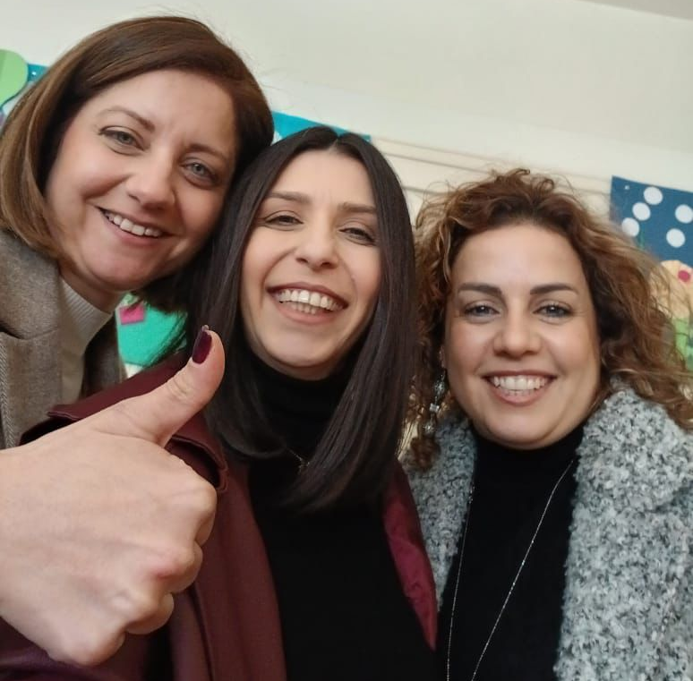
Teachers’ Voices
Lalmoudaress Community of Influential Educators
From its earliest moments, the community became a space where teachers were not expected to adopt ready-made models, but were invited to question, adapt, and co-design solutions grounded in their context. The kick-off meeting introduced a shared vision, yet it was the teachers’ reflections that shaped the direction of the work.
The second gathering moved directly into the realities of Lebanese classrooms, where educators openly unpacked daily constraints and explored Ed-tech solutions that could realistically support learner-centered instruction within those boundaries. Professional development opportunities were selected and shaped in response to teachers’ expressed needs, reinforcing the belief that relevance begins with listening.
As the community grows, we remain guided by our conviction: “intellectual humility - to learn as we go!”.

Slide 15
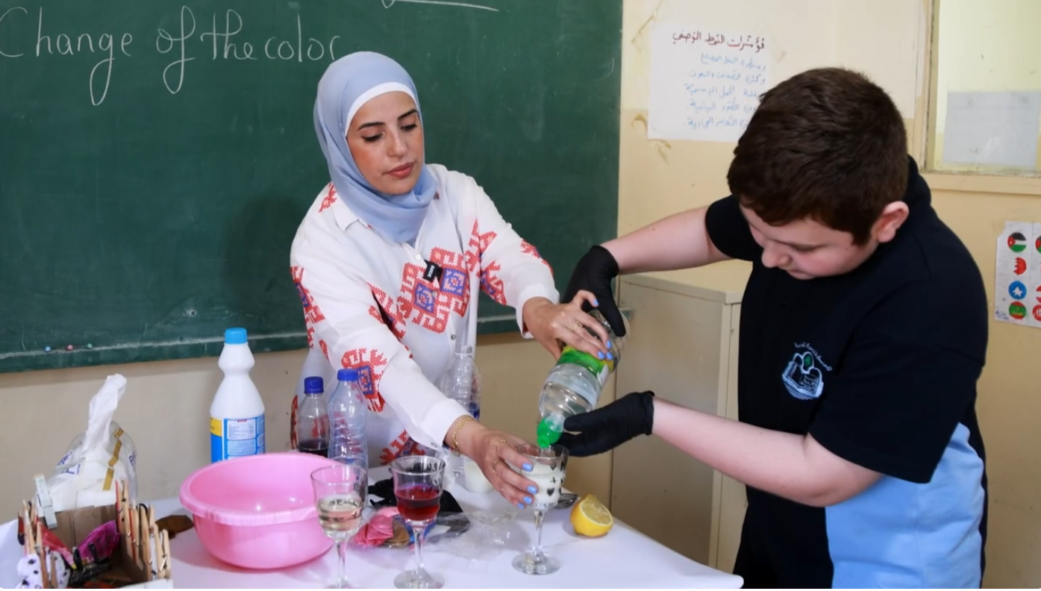

Teachers’ Voices
Advocacy Project
“As a teacher, I worked quietly, never expecting my efforts to be seen. I often thought no one felt the work behind the scenes. This project changed that.” These words came from one of the teachers who participated in the Lalmoudaress initiative and reflect the reality of many educators working in challenging contexts.
Through Lalmoudaress, LAL sought to recognize and amplify this often unseen work by visiting schools and documenting classroom practices as they naturally unfolded. Funded and supported by the Asfari Foundation, and implemented in close partnership with schools that welcomed us into their classrooms, the project focused on highlighting practical, educator-led approaches to teaching.
These stories showcased hands-on chemistry lessons that made abstract concepts concrete, creative labs built from reused materials, the integration of civic values into everyday learning, moments where students took on the role of teacher, and collaborative Arabic activities that strengthened communication.
Together, these practices illustrated how small, thoughtful teaching choices—made every day—can meaningfully shape students’ learning experiences.
Watch the full videos here.
Number of movies: 6 movies and 6 reels
Supported by Asfari Foundation-Influencing and Political Acumen Program with London School of Economics.

Slide 16

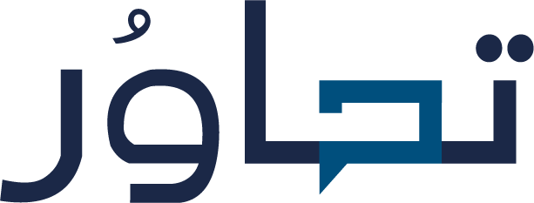
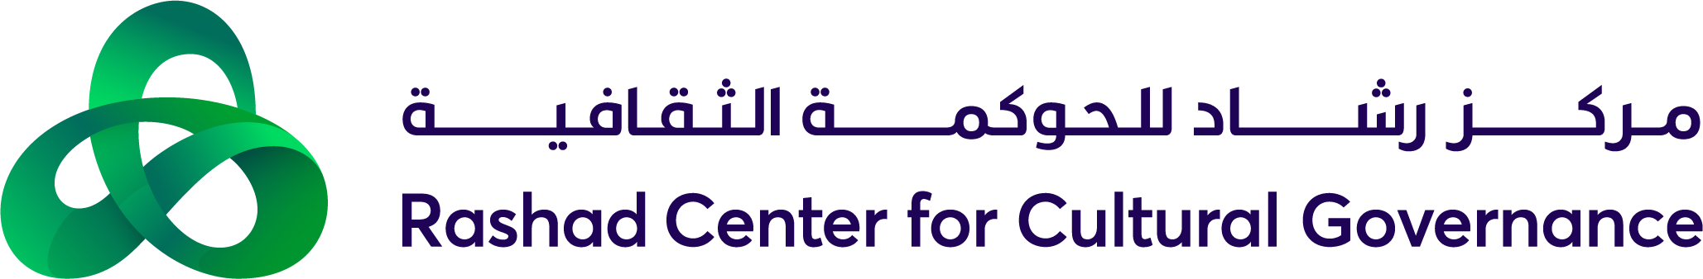

Tahawor
40 participants: 18 staffers, 17 civil society, 5 hosted experts
12 Tahawor Sessions
1 law amendment suggestion and 2 draft laws
Supported by Rachad Center for Cultural Governance - Adyan Foundation
Tahawor brought together Members of Parliament and their staff in structured roundtable discussions to advance values-driven reform policies. The initiative addressed key national priorities, including public service, justice, freedoms, transparency, human rights, education, and the environment. LAL was in charge of facilitating the discussions around Education.
Through a participatory approach that engaged MPs’ staff, civil society actors, experts, specialised NGOs, and research centres, Tahawor fostered cross-party dialogue and collaborative drafting processes that resulted in 1 law amendment and 2 new laws proposal.
Amendment to Law 73: Prioritize school principal candidates with a master’s in education management, impacting salary and retirement benefits.
New Law – Teacher Professional Development & Micro-Credits: Structured teacher training with automated needs assessment, core and elective topics, and micro-credits recognized as diploma/master’s-level credits.
New Law – Validation of Acquired Experience (VAE): Certification system recognizing experience and micro-credits, mandatory continuous training points, flexible career paths, and monitoring to meet evolving educational needs, including AI integration.

Slide 17
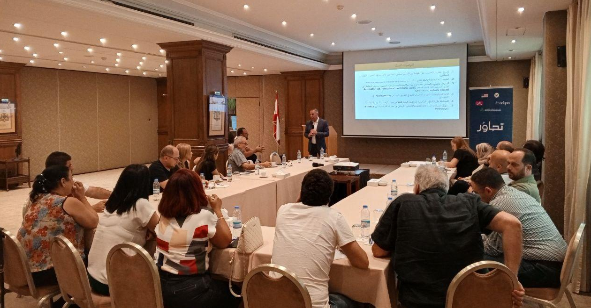
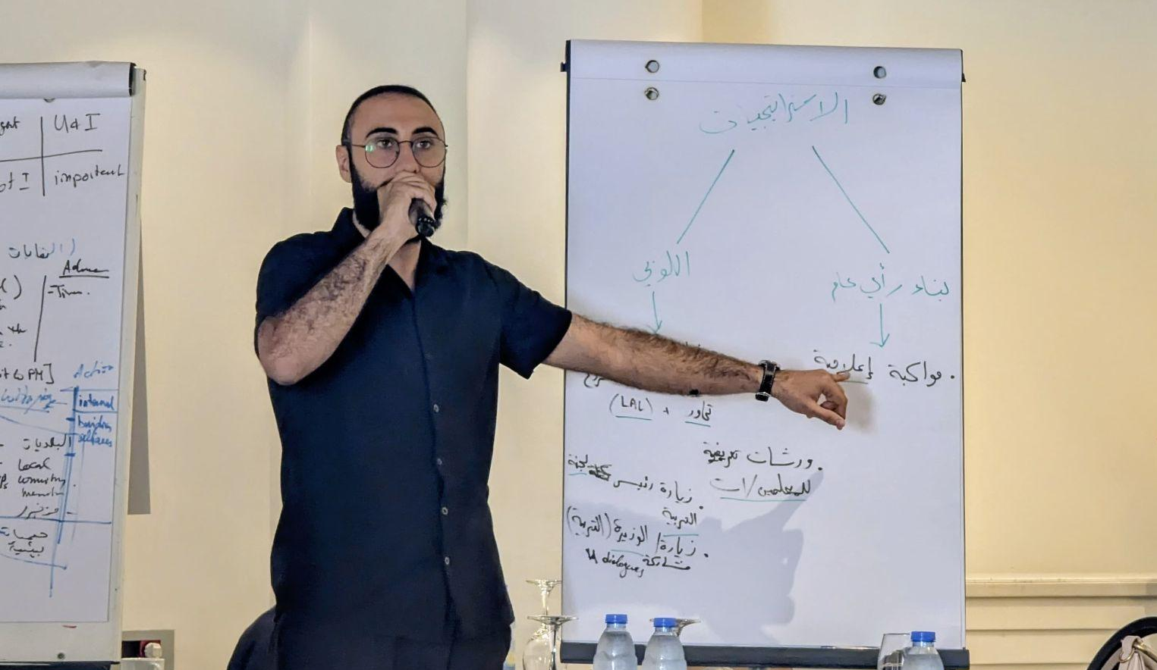
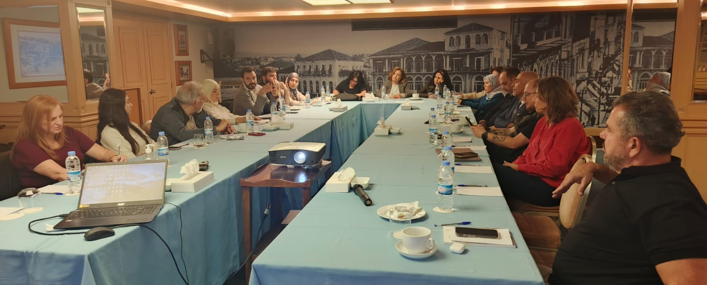
Tahawor
The project contributed to strengthening inclusive governance practices and promoting a more constructive political culture in Lebanon.
Impact: Mobilized Lebanese parliamentarians and their support staff to discuss and develop long-term values-based policies, building consensus that supports more genuine, democratic governance and policymaking processes.

Slide 18

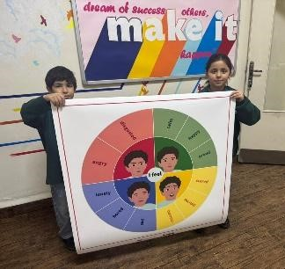
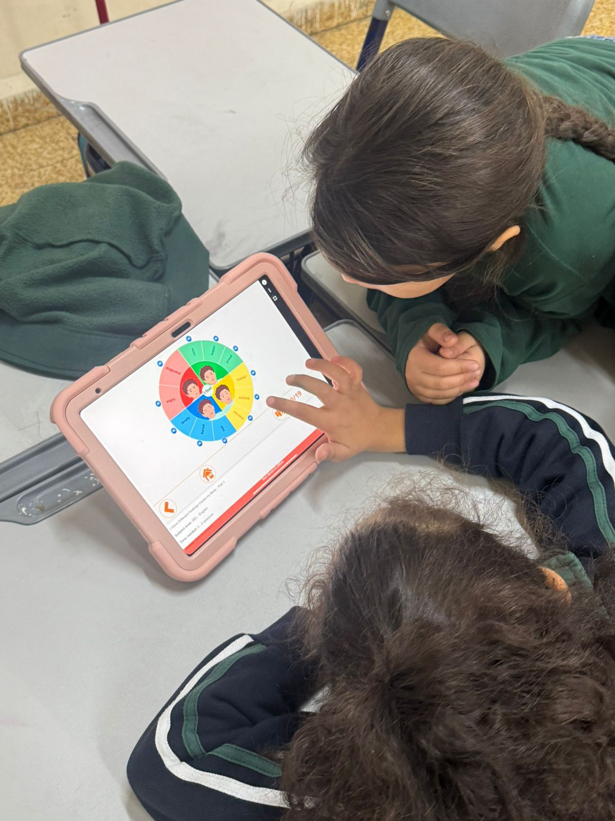
Happiness Curriculum Pilot
Beneficiaries = 69
Teachers = 3
Students = 66 (Grade 2 and 3)
Supported by Dalia and Ramzi Rishani Charitable Fund
This year marked an exciting milestone as we brought the Happiness Curriculum to life! Our goal was to create a digital space where students could explore Social and Emotional Learning (SEL) skills like self-awareness, emotional regulation, and a sense of belonging. We focused on building interactive modules on Tabshoura, designing them to be more than just lessons—they are student-centered experiences that make "big" feelings easier to understand and manage.
We put our work into practice at Makassed Ali Ben Abi Taleb School, advocating for an SDL approach in implementation. It was incredible to see the content in action; teachers embraced these new SEL tools with genuine enthusiasm, and students jumped into the activities with curiosity and energy. While we are still waiting for formal data, the initial response from both educators and learners has been wonderfully positive. This pilot has shown us that our tools are ready for the classroom, giving us a clear and hopeful roadmap to develop the rest of the curriculum material and bring these essential wellbeing tools to even more schools in the year ahead.

Slide 19

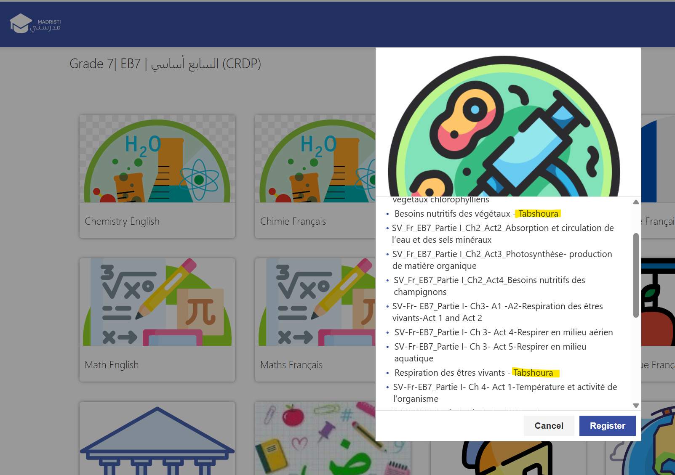
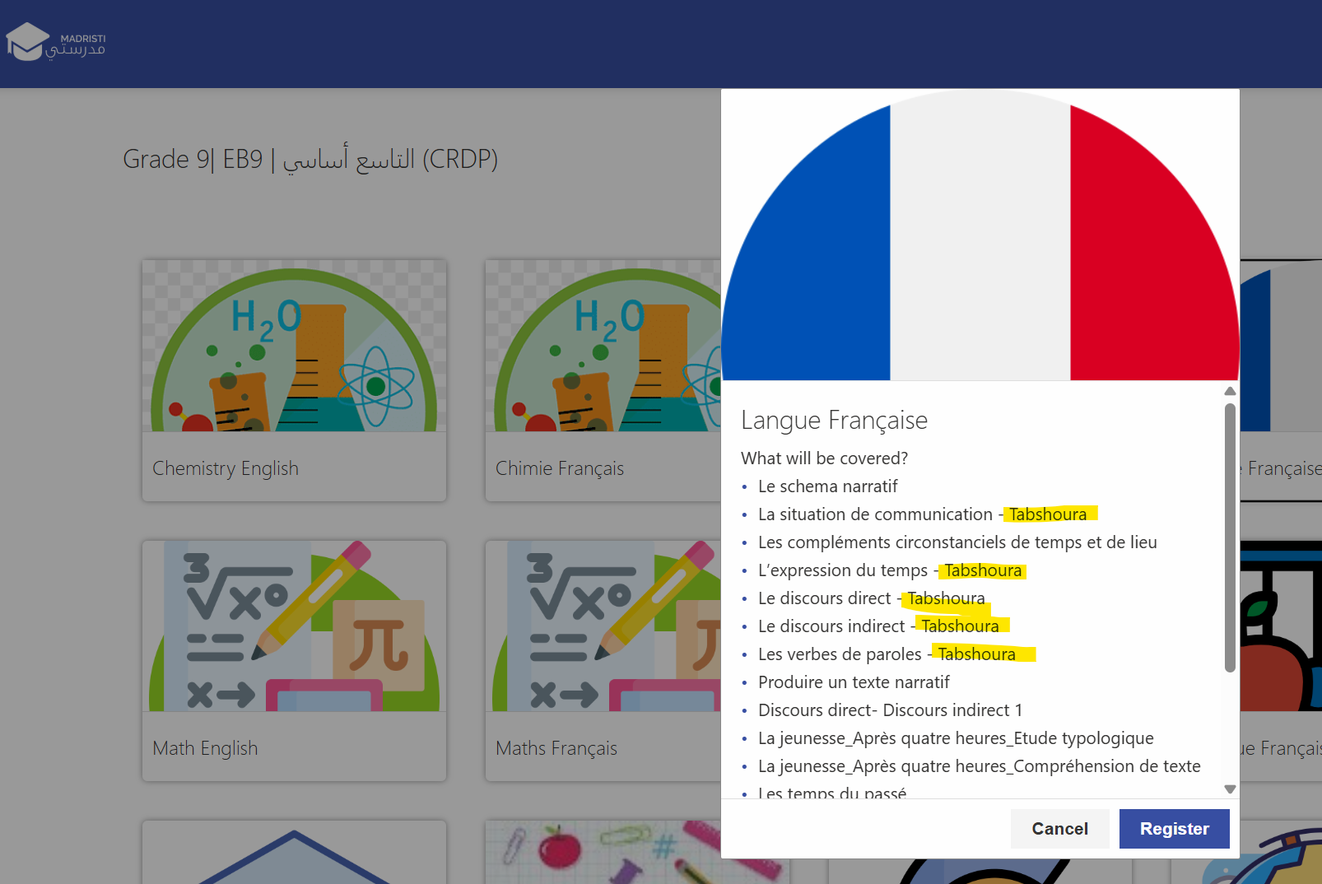

Integration on Madristi
Lebanese Alternative Learning (LAL) collaborated with the CRDP to validate its Math and Science content for middle school and successfully integrate it into Madrasati, UNICEF’s national platform for learning continuity.
This integration ensures that high-quality, curriculum-aligned digital resources are widely accessible, supporting students across the country and contributing to national education recovery efforts.

Slide 20
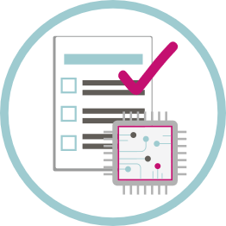
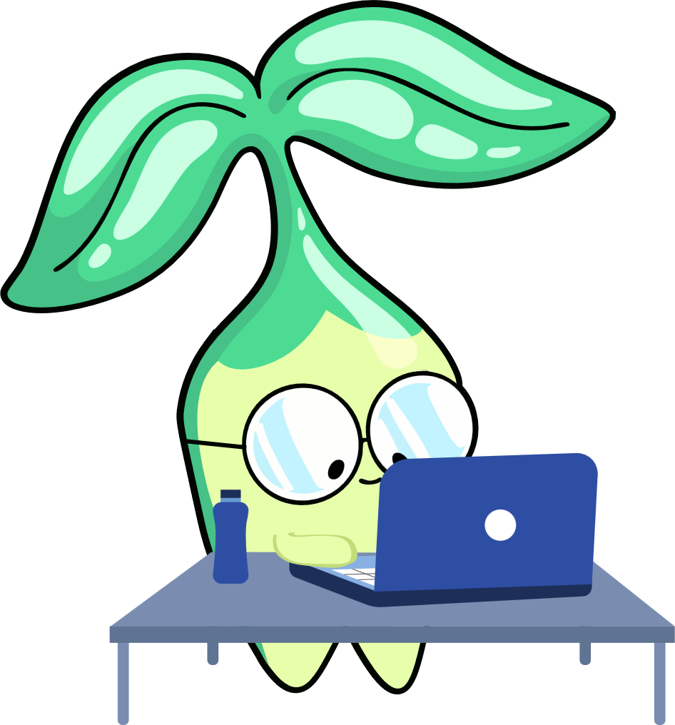

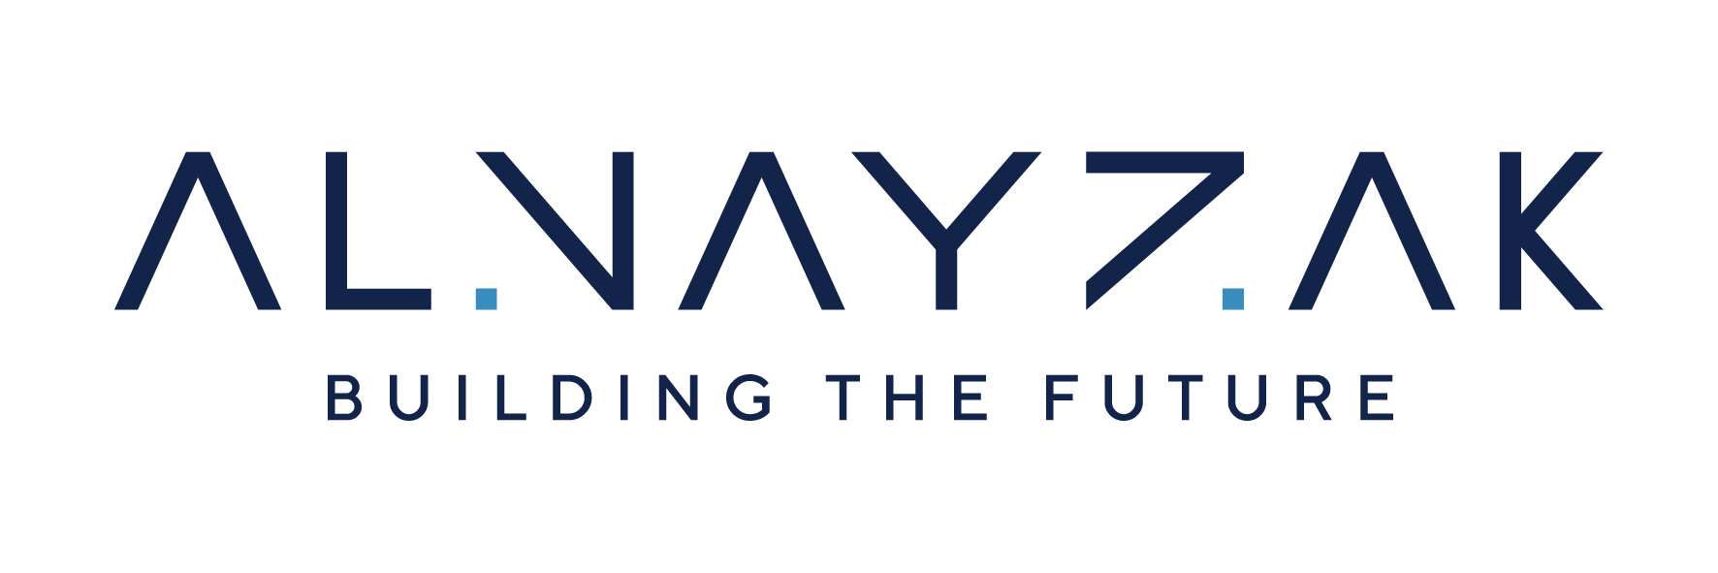
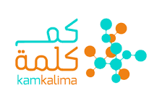
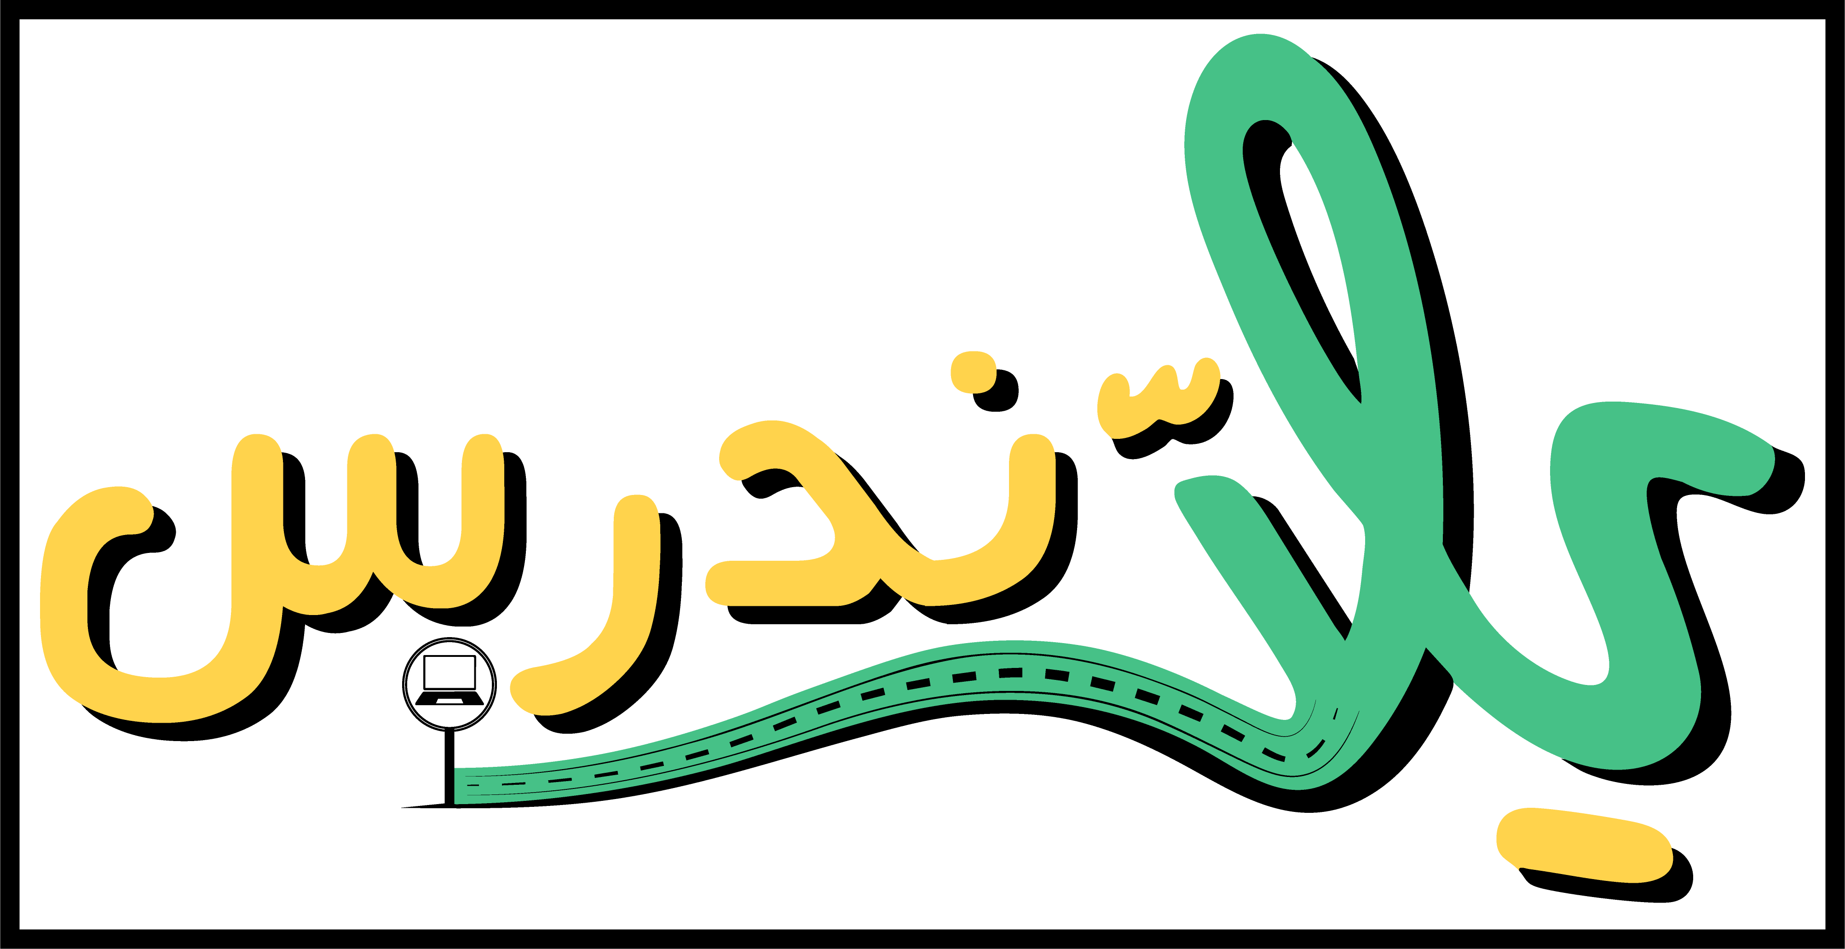
EdTech in Palestine
Units Published: 60
School Reached: 8
Students Reached: 1610
Teachers Reached: 90
The “Yalla Nodrus” project is a collaborative initiative between Kamkalima from Lebanon and AlNayzak from Palestine, supported by AlFanar. It builds on the experience and content of the Lebanese Tabshoura platform, adapting it to meet the educational needs of Palestinian students.
The project focuses on:
Content adaptation and transfer: Lebanese Alternative Learning (LAL) has modified its existing Tabshoura resources to align with the Palestinian curriculum.
Digital learning platform creation: The adapted content is delivered through a new platform called Yalla Nodrus, providing students with a flexible and accessible learning environment.
Support for students and educators: The platform empowers students to engage in self-directed learning while also supporting teachers with digital tools and resources.
Scalable educational solution: By leveraging an existing digital model, the project aims to offer a sustainable, high-quality educational experience in contexts where traditional schooling may face limitations.
In short, Tabshoura for Palestine is a bridge between proven digital learning methods and the unique needs of Palestinian students, ensuring continuity of learning and access to engaging, curriculum-aligned resources.

Slide 21
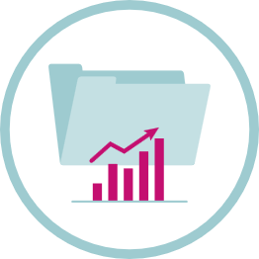
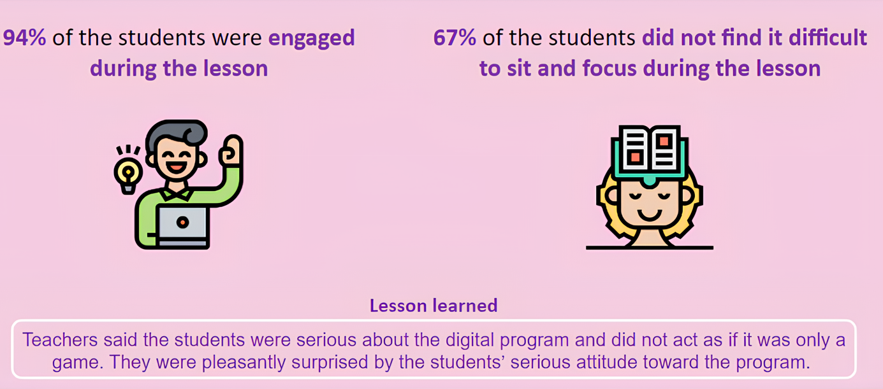
Data in Action: Smart Decisions, Stronger Impact
“Knowledge begins with observation”- Ibn Sina
This year, we took our data strategy to the next level. By centralizing our systems and being intentional about data collection, we ensured the privacy of every user while staying true to our core values. Working hand-in-hand with our Technology team, we transformed data into clear, actionable visualizations, upgraded our collection tools, and fostered stronger cross-department collaboration. These improvements have made our data not just a record of activity, but a powerful tool for insight, decision-making, and driving impact across the organization.
My Best Start Pilot Program (2021): Student Motivation and Engagement

Slide 22
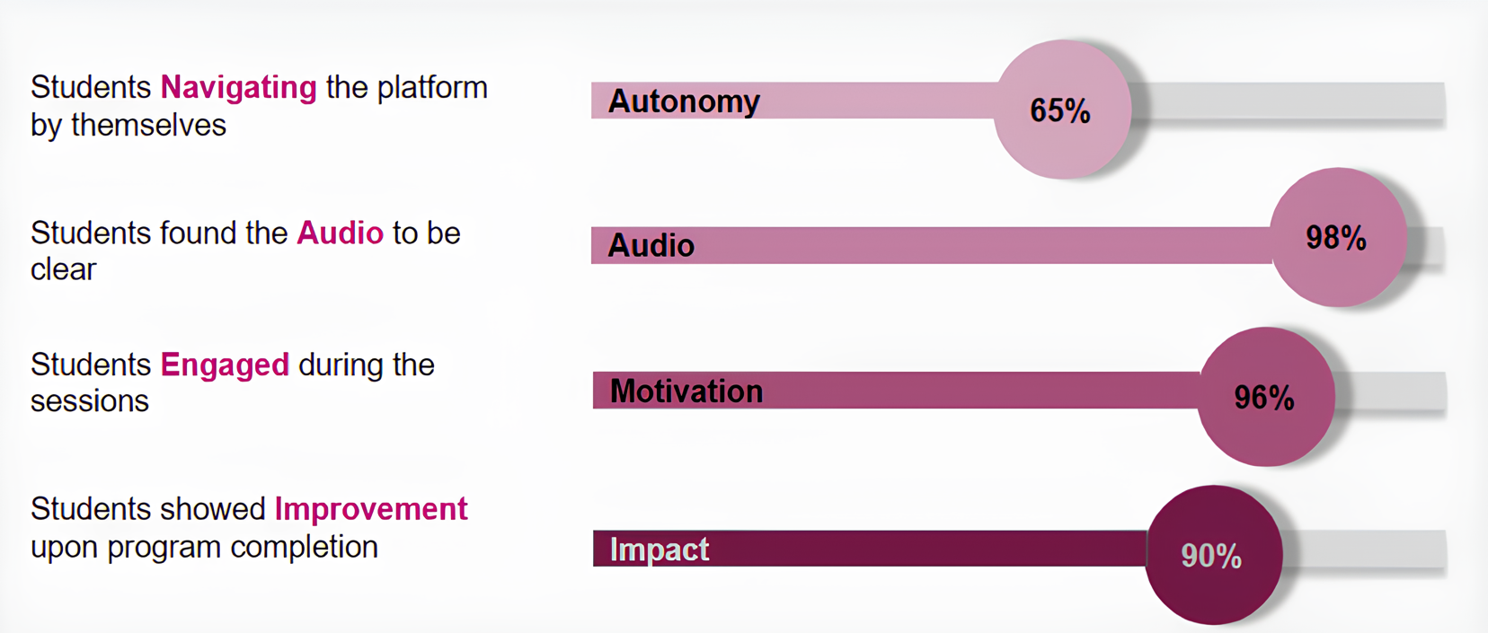
Data in Action: Smart Decisions, Stronger Impact
“Knowledge begins with observation”- Ibn Sina
Through strengthened Monitoring, Evaluation, Accountability, and Learning (MEAL) practices, data is now actively used to inform strategic and operational decisions, helping teams identify what works, adjust approaches where needed, and continuously improve program design and delivery. This approach ensures that evidence and learning remain at the center of our work, enabling LAL to respond more effectively to evolving needs and maximize the impact of its initiatives.
Basic Literacy & Numeracy Pilot Program (2022): Student Engagement with Platform Navigation Tools

Slide 23
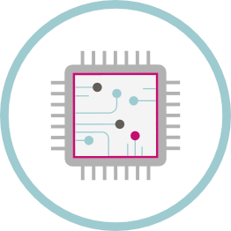
Tic Tech Tac
Supported by Asfari Foundation
In partnership with Beekee, a social tech startup
Tech Highlights: Empowering Pedagogy Through AI
AI Integration: Automating internal processes to allow our team to focus on creativity and pedagogy rather than technicalities.
Data-Driven Insights: Implementing AI analytics to make decisions that prioritize learner journeys and platform performance.
Building an AI-Savvy Team: Leading LAL’s internal AI education through curated courses and hands-on training with AI tools, ensuring our entire staff is equipped for the future of EdTech.
Infrastructure & Security: Completed a full system audit to harden data security and scale our servers for increased regional demand.
Field Resilience: Conducted rigorous pre-deployment testing of Beekee boxes, resulting in a stronger technical partnership and more reliable offline learning deployments in remote lebanese schools.

Slide 24
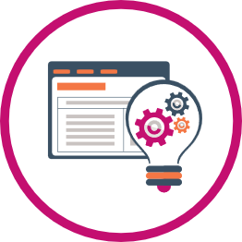
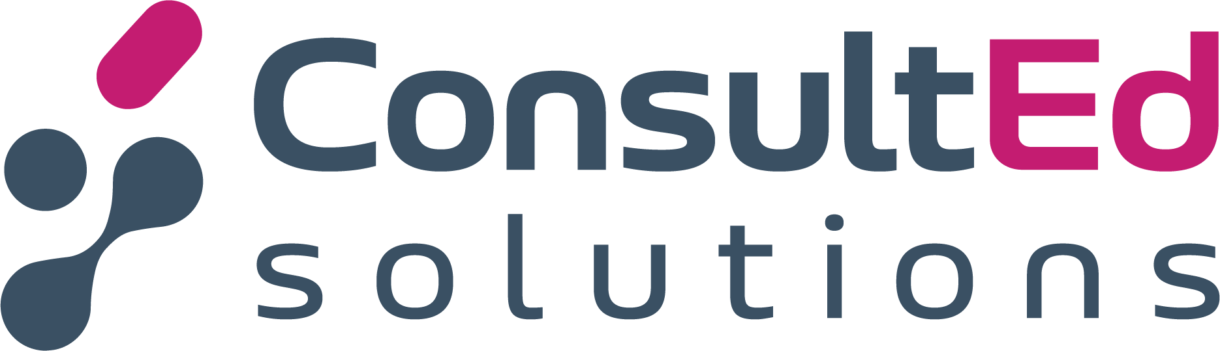



ConsultEd Solutions
Over the past year, ConsultEd Solutions delivered several large-scale projects with international partners, demonstrating its ability to manage complex contracts while combining instructional design, digitization, and content production.
UNRWA
Delivered a large-scale digitization project covering the entire Palestinian curriculum in Arabic. The project demonstrated LAL’s capacity to manage complex education contracts while combining technical digitization with high-quality Arabic educational content.
UNESCO
Designed and produced a comprehensive digital training course, including one hour of animated content in English and French. The project also included a capacity-building workshop in Dakar for education ministry representatives from fifteen Central and West African countries.
IECD / Semeurs d’avenir
Our collaboration with IECD / Semeur d’avenir is long-standing. We have been working together for several years on content development and digitalization projects. In 2025, we successfully completed 10 courses together in two languages—English and Arabic. These courses covered a range of topics, including PSEA, sales, digital marketing, gender equality, and others. We look forward to continuing and strengthening this partnership in the years to come.

Slide 25
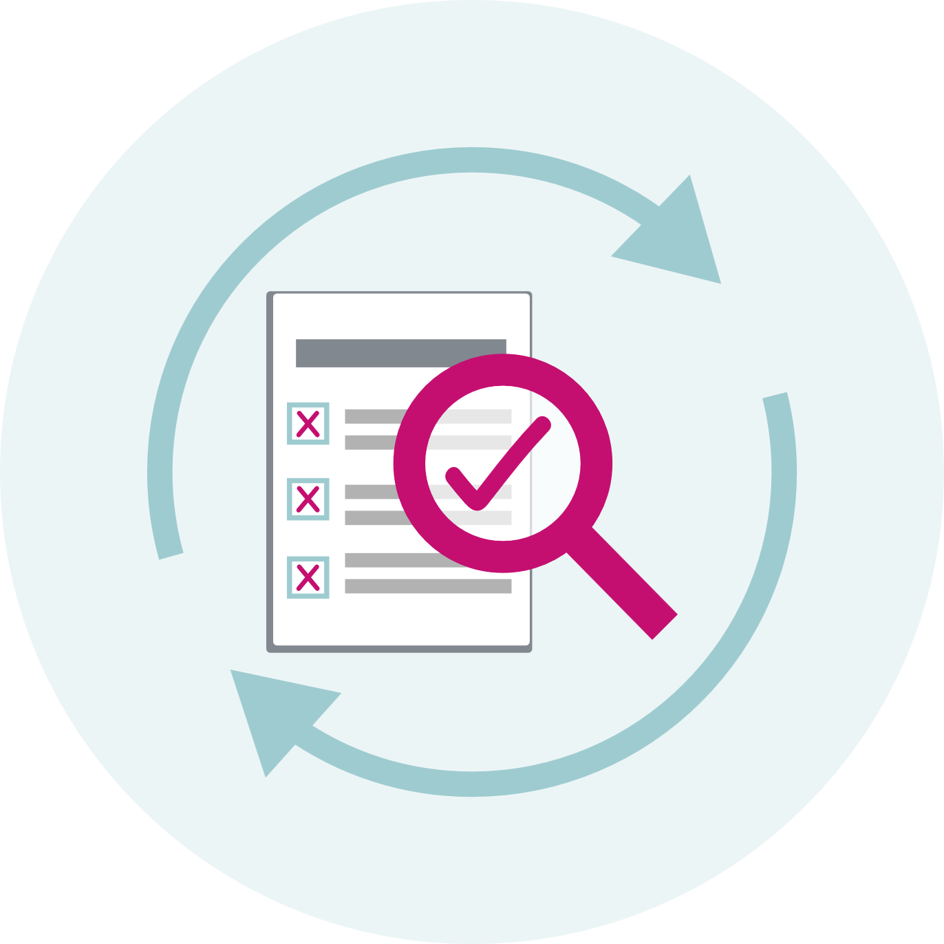
FAIL FORWARD
Lessons learned
At LAL, we believe that failure is not the opposite of success but a step toward it. ‘Fail Forward’ is our commitment to learning from challenges, adapting, and continuously improving. By embracing setbacks as opportunities for growth, we refine our approach, strengthen our impact, and push the boundaries of innovation in education.

Slide 26

Learning Along the Way
“Never take anything for granted”.
Always be prepared for unforeseen
The shortfall
While developing the pedagogical methodology for our Alternative Learning Spaces, we initially aimed too high, creating a model that was ambitious and difficult to implement.
The mitigation
Through reflection and iteration, we applied layers of simplification, refining our approach to reach a methodology that is now practical, effective, and working seamlessly in the field.
The shortfall
In our work on the Alternative Learning Spaces, we did not fully anticipate unexpected delays and initially lacked backup plans—Plan B, C, or D—to respond quickly.
The mitigation
Over time, we adapted by building flexible contingency strategies, allowing us to react faster and ensure the smooth implementation of our programs.

Slide 27
A Last Word
As we completed this annual report, a new war has erupted.
While bombs fall and uncertainty grows, our team continues to work relentlessly
to ensure education reaches those affected, through webinars, follow-ups,
tech solutions and content creation.
This moment also reminds us that, no matter how much we focus on good governance or the principles of the organization as a “greater good,”
it is ultimately the people who give it life and purpose.
LAL is the sum of extraordinary individuals whose dedication makes its heart beat.
I want to express my deepest gratitude to each and every one of them.

Slide 28





THANK YOU
Click on the icons below to follow us

