Slide 1


ANNUAL REPORT 2020
EVOLUTION IN TIME OF PANDEMIC
The second floor

Slide 2
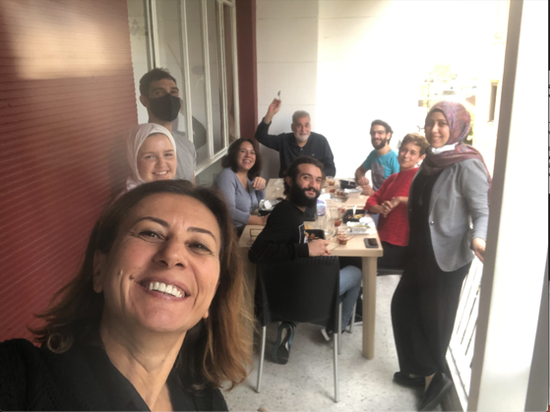
EDITORI-LAL
What can we say about a year like the one that just passed? Between pandemic and distance learning spread, bank crisis and digital resource banks, explosion and expansion, LAL continued growing fast, trying to adapt and develop new digital education solutions to answer new realities and a higher demand of digital support programs. We hired more staff, whom I would like to welcome into LAL’s family. We also had to move our office from the first to the second floor in the same building to have more space and initiated additional projects and dreams.

Slide 3
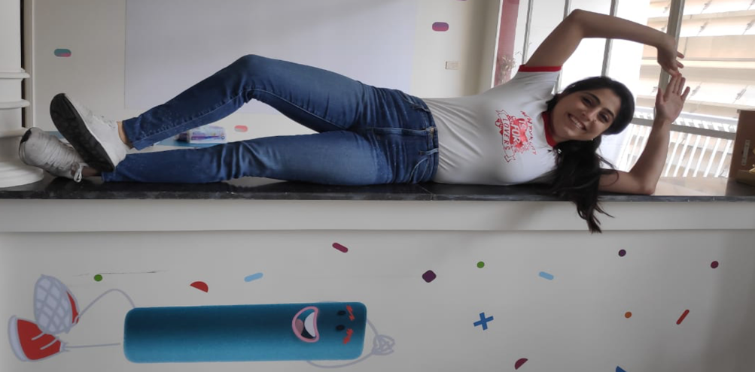
THE SECOND FLOOR: A GREAT MOOVE!

Slide 4
TEAMING
LAL’s family grew bigger this year.
Some of our external consultants joined the team.
We also hired newcomers.
Let’s welcome consultants who became team members:

Slide 5
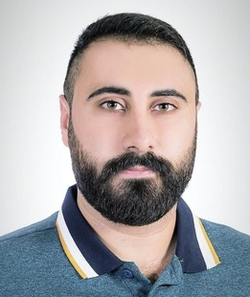
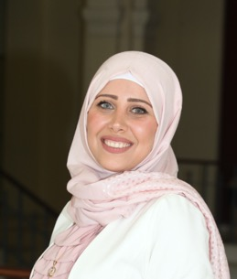
TEAMING
Ahmad Shaiban
Souhaila Nassar
Ahmad developed physics units while pursuing a master’s in project management. For Ahmad everything is always ”tamem” and sometimes “kteer tamem”. With his positive spirit and eagerness to evolve, he joined the team as a Project Manager for capacity building and development.
Souhaila started at LAL by developing Chemistry units while pursuing a master’s degree in education at AUB. Souhaila’s knowledge in new educational pedagogies was valuable. We are very lucky that she joined our team as a Project Manager for Remote Pedagogy and Distance Learning.

Slide 6
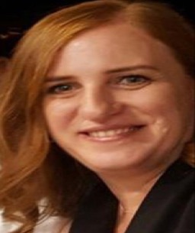
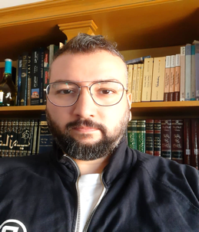
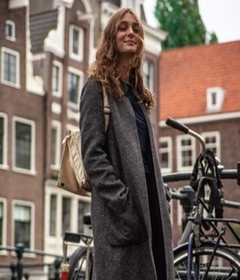
TEAMING
Hala El Chacar
Elie Assaker
Yara Jabbour
Hala is more than a translator. She combines her love for the right terms with her dedication and her ability to work in a team. She joined LAL as an Expert Translator and Language Editor.
Elie started at LAL by developing Arabic content. He multitasks and navigates between Arabic literature and media and communication expertise. He joined the team as a Project Manager for Arabic Content and Digital Transformation of partners’ programs.
Yara graduated from the University of Amsterdam with a BS in New Media and Digital Culture. With her smile and skills, she joined the team as a Communications Officer.

Slide 7
TEAMING DURING CONFINEMENT
The need for distance learning increased during COVID-19.
While confined at home, we tried to deliver new chapters to help students keep-up with school.
We gathered a team of volunteers and worked all around the clock to develop, edit and translate more units.
In a month’s time, we succeeded in publishing 9 units, translating 7 and editing around 5.
Thank you to Georgia També, Andrea També, Rosy Raggi, Joelle Kosremelli, Sarah-Jane Fahed, Mazen Fahed, and Ralph Salloum for your help in reviewing and translating units during confinement.
A special thanks to our ‘Senior’ volunteer; Jeannette Salamoun. Jeannette is now retired but has been a Chemistry teacher at CLW for all of her professional life. She’s contributed a lot to LAL between 2019 and 2020 translating more than 10 scientific modules from English to French.

Slide 8
PARTNERING
We developed new partnerships that enriched us and gave us new perspectives.
Thanks to Inspiration Garden, we learned how to listen to the teachers and understand their needs, challenges and hopes. We successfully adapted the Learning Lands process to the UNRWA Grade 1 pilot project and the remote pedagogy projects, making the teacher at the core of the solution.
With Education Above All and the Internet Free Education Bank project, we were exposed to a new approach of distance learning that does not involve a screen but engage the child with his direct environment.

Slide 9
PARTNERING
B.O.T (Bridge. Outsource. Transform) is an impact sourcing platform that provides high quality digital services executed by skilled freelancers from marginalized communities in Lebanon. We gave trainings on content development to BOT selected consultants in order to partner together on providing content creation services.
With FIWI, we got wiser in financial literacy. We are now developing a specific program to transfer that wisdom to teenagers by addressing public and private good, growth, social rights and duties, money, banks, and much more. It is indeed important especially lately for teenagers to understand what is happening in our finance and banking sector and ease the anxiety they feel when they hear their parents complaining about the current economic crisis.

Slide 10
REACH
Our users increased potentially and more than 30,000 registered to our online platform from all Lebanese regions and even from abroad.
We reached out new beneficiaries, built new collaborations with NGOs and education institutions.
We worked hard during confinement to develop more content
Let’s take a look at what we achieved:

Slide 11
REACH
+30 000
Increase in platform users
Baseline: 5 000
+ 8
Partners NGO
Baseline: 12
+ 500
Teachers
Baseline: 110
+ 140
Tabshoura-in-a-Box distributed
+82
Interactive digital Units
developed under P&S
20
Projects for Grade 1 in math and English
+24
Project-based units
+174
Middle School Units

Slide 12

PROCESS AND PROCEDURES
With Alfanar
How else can we resist the chaos of the multiple crises if not by putting structures in place?
As a small NGO, we used to manage our day-to-day operation in a convivial manner without giving much importance to procedures. While growing, procedures became important. We became aware that the fear of losing our friendly way of proceeding was no longer relevant.
In fact, setting up procedures makes it more equitable, more transparent and thus, protects our coworkers and avoids conflicts due to miscommunication and bad governance.
We were very fortunate to have Alfanar's support. Together with Michelle, Lea and Haifa, we revisited our mission, our vision, rethought our plans and reviewed our structure. We developed business plans and strategies and revised our organizational chart to meet the actual and expected growth. We developed our procedures and policies with APAVE and worked on our communication strategy with Roof 11.
We adopted “ZOHO Projects” for project management and “Qlik” for data analytics and built new SOPs as well as revisited our strategies and planning.

Slide 13
POLICIES
While working on our policies, we understood that they’re not only words on paper to show donors that we care about equality, environment, and child protection, but that it is really about embracing those principles in our work and life.
All LAL employees should read these policies and commit to abide by them.
Child protection
Environmental policy
Equality
Whistle-blowing
Human rights
Anti-terrorism commitment
Climate change commitment
Anti-Harassment
Notes:
“Policies are a course or principle of action adopted or proposed by an organization or individual”. Oxford languages, languages.oup consulted on Jan 4Th 2021

Slide 14
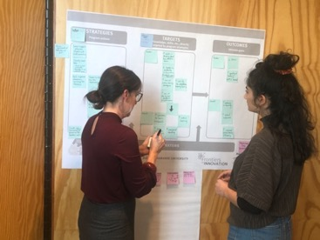

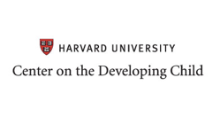

THEORY OF CHANGE / IMPACT MONITORING & EVALUATION
WITH
MIT SOLVE, Harvard Center of the Developing Child, and Queen Rania Foundation
Through our one-year support from MIT SOLVE, we worked with wonderful people and got the chance to visit MIT in Boston and meet inspirational speakers.
We had the chance to be connected with the Queen Rania Foundation and Harvard’s Center on the Developing Child. It helped us a lot through the development of our Theory of Change.
Caroline Hoy - the director of the Impact, Monitoring and Evaluation department - helped us draft our strategy and updated our evaluation tools.

Slide 15
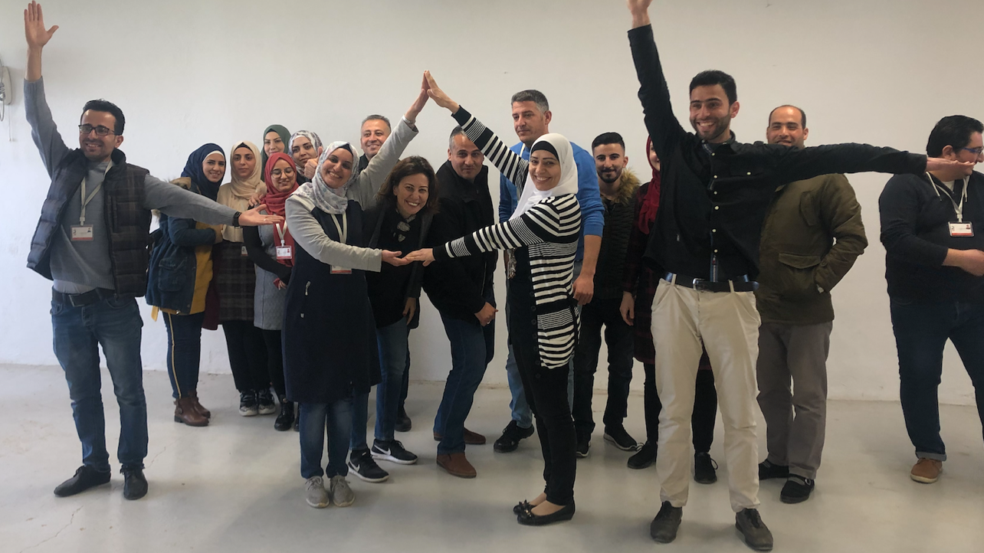
COMPLETED PROJECTS

Slide 16
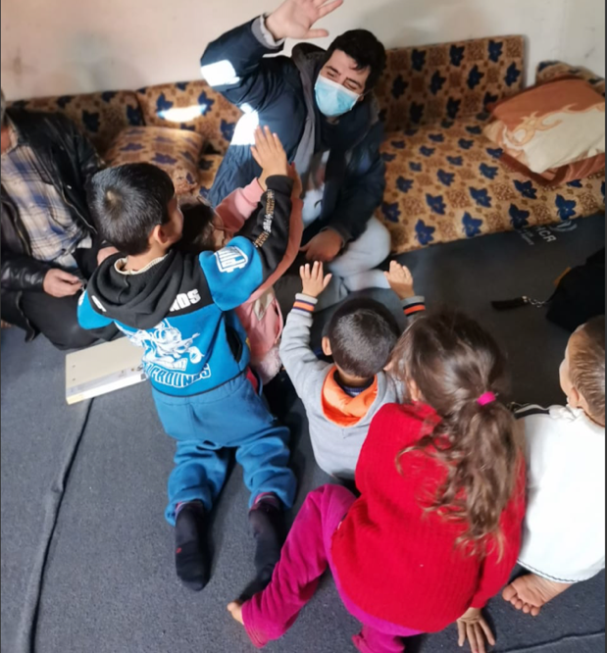


REMOTE PEDAGOGY
Malala Fund and Saint-Gobain
Thanks to the generosity of Malala Fund and Saint-Gobain Foundation, we developed a remote capacity building strategy, installed platforms and ensured remote capacity building workshops to 3 organizations, developed tutorials, and offered guidance to teachers reaching children at home with distance learning.
100
Tabshoura in a box distributed
3
Platforms installed
80
Teachers trained

Slide 17

REMOTE PEDAGOGY
Malala Fund and Saint-Gobain
With Inspiration Gardens and through the Learning Land process,
we were able to build a community of teachers who worked together to develop resources on distance learning that will be published on a dedicated website.
We were able to achieve this through 5 events:

Slide 18
REMOTE PEDAGOGY
Malala Fund and Saint-Gobain
1- WonderLand: 66 educators from the north wondered & reflected on their own remote learning experience. By the end of the 4 hours in-person event, a report was out to showcase the educators’ major wonders.
2- CollabLand: 30 educators from different backgrounds along with researchers, academics, specialists and social innovators co-created and co-designed tools to support educators’ wonders. We gave 60 networking and co-creation workshops for that event.
3- AnswerLand: 33 Workshops were delivered from experts, practitioners and co-creators to provide answers and practical strategies according to educators’ needs and interests! All workshops were provided through an e-bag for later use! This event had 1720 attendees.

Slide 19
REMOTE PEDAGOGY
Malala Fund and Saint-Gobain
4- DeepDiveLand: Educators joined Communities of Practices (COPs) to dive into what they have learned, deepen their understanding, sharpen their remote pedagogical skills and impact their classrooms from different backgrounds!
5- ReflectionLand: Educators reflected on their own growth throughout the Remote Pedagogy project, gave feedback about the program and how we can further support them!

Slide 20
BRIDGE TO HIGH SHOOL
It’s been 4 years that we have received an unconditional support from Malala Fund. Through this privileged relation, we were able to adapt our Bridge to High School project to respond to the new COVID-19 rules and regulations. In order to support teachers in distance teaching, we developed Integrated Digital Evaluation Mechanisms (IDEM) that help teachers in assessing the specific gaps and measure the impact of learning.
Project duration: 2 years
Partners: Nabaa, Basmeh & Zeytouneh
Objective: Accelerate the learning process and measure the impact of the support units developed.
Description: Create placement and evaluation tests (pre and post the completion of the units) to identify the specific learning gaps in order to address them and measure the impact of the learning through Tabshoura digital units.
Team:
Project Manager: Muriel Albina
Team: Ahmad Shaiban, Souhaila Nassar, Nelly Abdallah, Bilal Katerji

Slide 21


Implemented by
BRIDGE TO MIDDLE SCHOOL
Through a sectorial project funded by BMZ, The German Federal Ministry of Economic Cooperation and Development, we completed Grade 6 level, creating a bridge from elementary to middle school
Let’s take a closer look at this project:

Slide 22
Implemented by
BRIDGE TO MIDDLE SCHOOL
Beneficiaries: Grade 6 students
Project duration: 6 months
Objective: Support students to transition from elementary level to middle school by strengthening their learnings, autonomy, and analytical thinking.
Description: 97 Math, Science, Arabic, French, English and Geography units covering Grade 6 level were developed, translated, edited and published. (French 10 ; English: 29; Arabic: 20; Math: 19 ; Sciences: 19)
Team:
Project Manager: Romy Melki Moukarzel
Content Developers: Marie-Joe Ghorra, Maya Kourani, Rebecca Aammar, Samia Kassis, Ines Colot, Lucas Journel, Souhaila Nassar, Muriel Albina, Yara Ibrahim, Nelly Abdallah, Ahmad Shaiban.
Link: https://middleschool.tabshoura.com/

Slide 23
Implemented by
SUSTAINABLE FACILITIES MANAGEMENT
SUFA
GIZ’s continuous support helped us in our growth and diversification.
Let’s take a closer look at this project:

Slide 24
Implemented by
SUSTAINABLE FACILITIES MANAGEMENT
SUFA
Length: 1 year
Partners: Free, Difaf, Atelier Hamra
Objective: Engage the students in inquiry-based projects to create environmental awareness.
Description: Develop 15 environmental inquiry-based projects, 13 socio-economic projects, and 9 communication and digital literacy projects. All these different units have the same goal: to raise the awareness of the students on their environment and provide teachers with project-based resources to enhance learning.

Slide 25
Implemented by
SUSTAINABLE FACILITIES MANAGEMENT
SUFA
Team:
Project Manager: Romy Melki Moukarzel
Research, development and content developers: Muriel Albina, Souhaila Nassar, Ahmad Shaiban, Yara Ibrahim, Areej Jbeily, Peneloppe Nacouzi, Elie Assaker, Jana Shahine, Hala Chacar, Maya Kourany.
We are looking forward to taking this project a step further in 2021 and increase our reach.

Slide 26




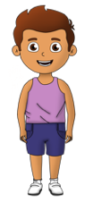


RIGHT TO PLAY
A project with and for UNRWA Schools
With Right to Play, we created a pilot Grade 1 program for UNRWA, working closely with the teachers and pedagogical team to create 20 adapted projects in English and Math, discovering the power of learning how to play and playing our ways to learn.
Beneficiaries: UNRWA schools
Partner: Inspiration Garden, UNRWA school’ teachers
Objective: Support UNRWA schools’ teachers with distance learning
Description: Design and digitize English and Math activities for Grade 1 by collaborating closely with UNRWA teachers in the aim of aligning the digital programs to the learning objectives of the UNRWA curriculum.
Team:
Project Manager: Andrea Fahed
Content Developers: Samira Trawi, Narimane Ayoub

Slide 27
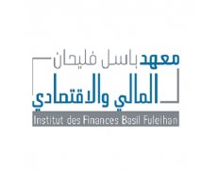
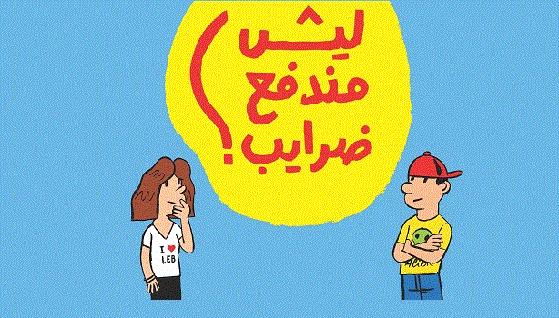
INSTITUTE OF FINANCE (IoF)
Hand in hand with the Institute of Finance, we engaged in a financial literacy project
to educate the youth on the complex world of public money.
Support: UNICEF
Beneficiaries: Youth above 16
Objective: Raising citizen awareness among young people in the areas of public finance.
Description: 5 subunits were developed addressing the following topics: public money, taxes, public debt, role of the municipalities and budgeting.
Team:
Project manager: Nayla Zreik Fahed
Content developer: Fahd Al Jurdi

Slide 28

TABSHOURA TINY THINKERS IN A BOX
Tabshoura Tiny Thinkers:
Support: MIT SOLVE
Beneficiaries: Early Childhood Education
Project duration: 9 months
Objective: Reinforce Autonomous thinking, Creative thinking and Analytical thinking from a very young age by creating story-based activities featuring local heroes.
Description: 2 story-based activities in Arabic, French and English: Abdemon the Phoenician super-hero is looking for the stolen alphabet and Akhwat Chanaï is bringing water to the palace.
Team:
Project Manager: Andréa Fahed
Team: Narimane Ayoub, Samira Trawi
Link: https://kindergarten.tabshoura.com/

Slide 29
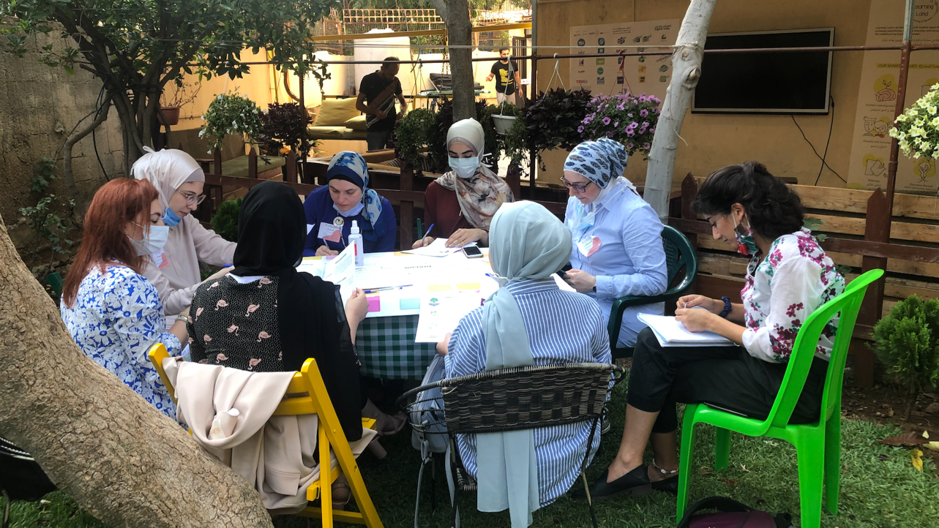
ONGOING PROJECTS

Slide 30

INTERNET FREE EDUCATION RESOURCE BANK
“Education Above All (EAA) is a foundation founded in 2012 by Her Highness Sheikha Moza bint Nasser. Its aim is to contribute to human, social and economic development through the provision of quality education.”
Funder: EAA
Project Manager: Souhaila Nassar
Partners: Inspiration Garden, Malaak, Jusoor, Ruwwad Al Tanmiya, Borderless, Social Support Society.
Objective: Pilot 12 internet-free projects and measure their impact.
Description: With our 5 partners, we selected 12 projects from the IFERB resource bank and adapted them to the Lebanese context and non-formal education. Teachers then piloted them with the students.
Team:
Project Manager: Souhaila Nassar

Slide 31
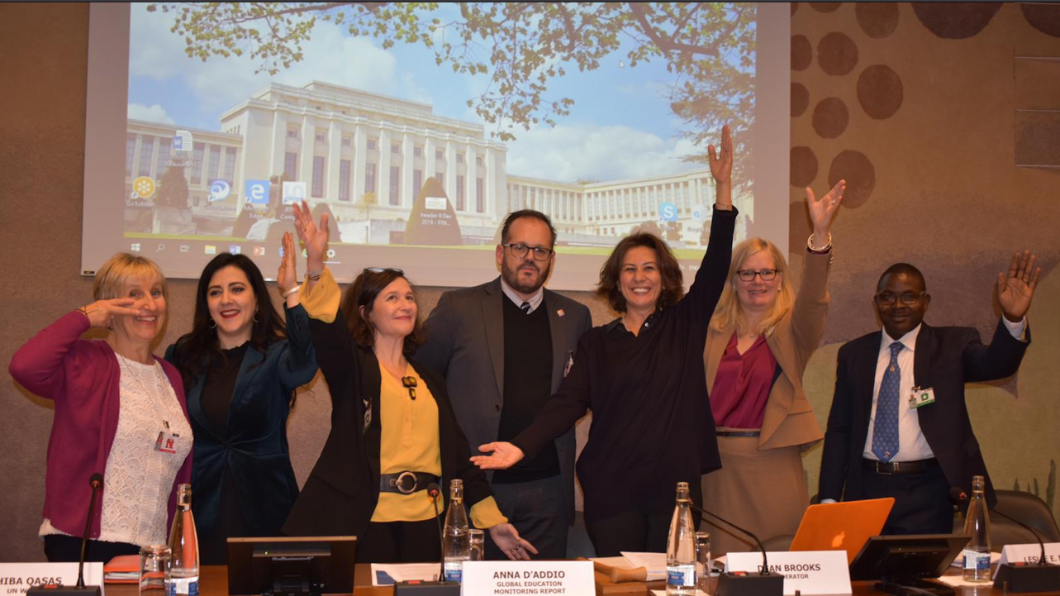
CONFERENCES AND WEBINARS
CONFERENCES AND WEBINARS

Slide 32

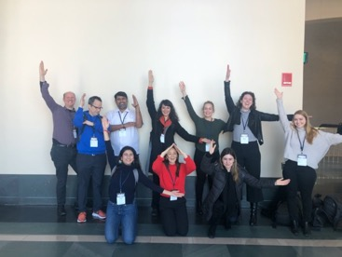



MIT SOLVE
BOSTON VISIT
When: January
Who: Andrea Fahed, Nayla Zreik Fahed
Where: Boston- MIT campus.
What: Tailor-made workshops on assessment and evaluation tools provided by Harvard Center of the Developing Child along with inspirational discussions by MIT professors.
VIRTUAL CLOSING EVENT
When: May
Who: Andrea Fahed & Nayla Zreik Fahed
What: Closure events with inspirational speakers (such as YoYo Ma), and chat rooms

Slide 33

ICESCO ROUND TABLE
When: June 22, 2020
Who: Nayla Zreik Fahed
Where: Virtual/Morocco
What: Round Table on Education in time of COVID. Challenges, Responses, Recommendations.
“In time of COVID do not reduce the learning to a screen. Invite the children to discover their own environment and learn from it. Why watch a video about a plant when they can go outside, pick a plant and observe its leaves, roots, and flowers?” – Nayla Fahed
Link: https://www.icesco.org/

Slide 34

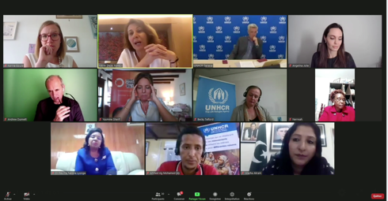
UNESCO-UNHCR HIGH-LEVEL ROUNDATABLE
Making sure that refugee students are able to learn at home and return to school after COVID-19
When: July 13, 2020
Who: Nayla Zreik Fahed
Where: Virtual/Paris
What: Participants heard from refugee learners and graduates, as well as Ministers of Education, about how their personal education experiences and national education systems have been affected by the pandemic, and how they are planning for the return to school for refugee learners.

Slide 35
UNESCO-UNHCR HIGH-LEVEL ROUNDATABLE
Making sure that refugee students are able to learn at home and return to school after COVID-19
The discussion was moderated by UNHCR Special Envoy Angelina Jolie.
Nayla presented the local context of Lebanon, the challenges, the solutions and gave some recommendations: “Learning is also about the forgotten philosophical concept of happiness. So, let’s add happiness as an essential component to all of our projects, let’s think about it as an important milestone.”
Link: https://www.youtube.com/watch?v=tL8xuQ1pa2M
Watch Nayla advocating for local education:
https://www.facebook.com/watch/live/?v=2669807693231247&ref=watch_permalink (minute 1:20)

Slide 36
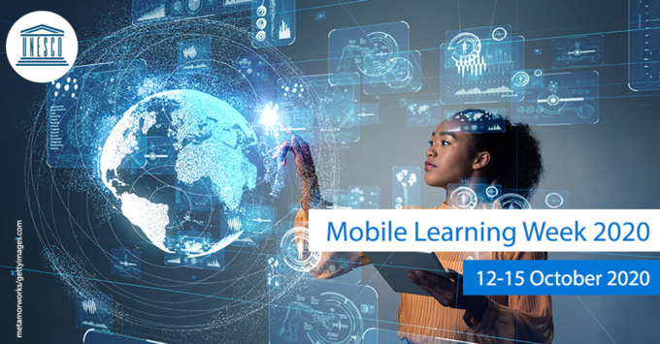
UNESCO MOBILE LEARNING WEEK 2020
Beyond Disruption - Technology Enabled Learning Futures:
When: October 12, 2020 to October 14, 2020
Who: Nayla Zreik Fahed, Patrick Habib, Souhaila Nassar
What: LAL’s team participated in breakout sessions

Slide 37
UNESCO MOBILE LEARNING WEEK 2020
Beyond Disruption - Technology Enabled Learning Futures:
On the 13th: Workshop of GIZ entitled “Ensuring context appropriateness and scalability of learning under COVID-19: What lessons are we learning?”
Nayla Zreik Fahed, Ismael Nouns and Dominic Orr discussed the challenges and the future of Ed-Tech solutions.
On the 14th: Learn from Lebanon - Rapid Digitization of Educational Content and Pedagogy - Making It Work in Low Resource Communities
This session was moderated by Ms. Dorothy Gordon, Chairwoman, Information for All Programs (IFAP). After a brief presentation, Patrick and Souhaila facilitated hands-on Tabshoura and moderated the discussion about solutions in challenging areas.
Link: https://en.unesco.org/mlw

Slide 38
UNESCO THE 4TH ARAB DIGITAL CONTENT FORUM
“The Future of Arabic Content on the Internet”
When: October 8, 2020
Who: Nayla Zreik Fahed
Where: Virtual
What: The Tabshoura project and the COVID-19 challenges in Lebanon.
Link: Arab digital content forum
UNEDU-FORUM EGYPT
When: December 3, 2020 to December 5, 2020
Who: Andrea Fahed, Narimane Ayoub, Samira Trawi
Where: Virtual/Cairo
What: Edu-forum is a platform for educators to interact with each other, attend workshops and lectures delivered by international and national well-known experts in the education field.
Link: http://eduforum-eg.com/

Slide 39
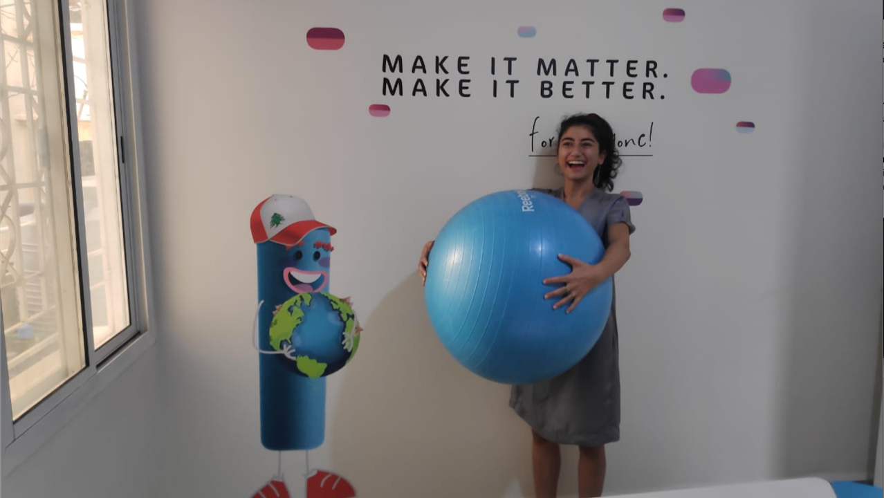
Sustainability
SUSTAINABILITY

Slide 40
PRODUCTS AND SERVICES DEPARTMENT
To address the current crisis and for LAL’s impact to scale, we launched our Products and Services department as part of LAL’s sustainability plan. Led by Patrick Habib, the department focused on providing e-learning solutions for organizations and educational institutions.
Overview of Products and Services for 2020:
Dedicated e-learning platform installation
Offline boxes
Digital content co-creation
Capacity buildings
Technical and pedagogical support

Slide 41
PRODUCTS AND SERVICES DEPARTMENT
Content Co-creation & Remote Capacity Building
Our “products and services” department succeeded in helping several organizations to adapt to distance learning.
Let’s take a look at what we achieved:

Slide 42
PRODUCTS AND SERVICES DEPARTMENT
Content co-creation & remote capacity building
8
E-learning platforms
installed
25
Services provided to 13
Different organizations
96
Capacity building workshops given
380
Teachers trained
5
Tabshoura programs
deployed

Slide 43
List of Provided services for Organizations
Organization | Services | Link
SSS | Platform and Capacity Building | http://sss.tabshoura.com
Dignity | Content Co-creation
Tahaddi | Platform and Capacity Building | http://tabshoura.tahaddilebanon.org
World Vision Children In Crisis | Platform, Capacity Building and Content Co-creation | https://cic.wvlb.org
World Vision Celebrating Families | Platform, Capacity Building and Content Co-creation | http://cf.wvlb.org
Jusoor | Platform, Capacity Building and Boxes | https://tabshoura.jusoorsyria.com
Malaak | Platform and Capacity Building | https://tabshoura.malaak.org
Include | Content Co-creation
Institute of Finance | Content Co-creation and Irada Baladiya website | https://www.iradabaladiya.org
DOT | Capacity Building
ProAbled | Platform and Capacity Building | https://academy.proabled.com
Basmeh And Zeitouneh | Platform and Capacity Building | https://tabshoura.basmeh-zeitooneh.org
Abaad | Platform and Content Co-creation
Notes:
Slide is hidden – present only to us

Slide 44
THE PRODUCTS & SERVICES TEAM
It wouldn’t have been possible without this amazing team!
Come meet our team members:

Slide 45
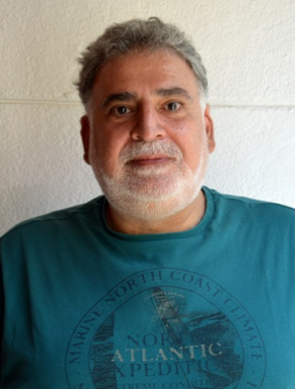
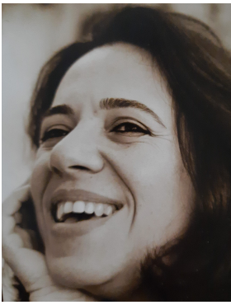
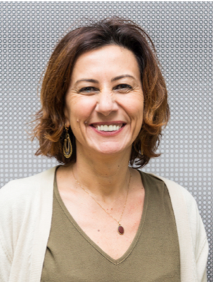
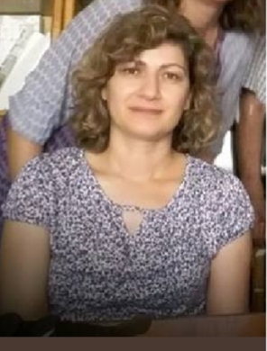
THE PRODUCTS & SERVICES TEAM
Nagi Ghorra
Romy Melki
Nayla Zreik Fahed
Zahra Haidar
Technical Trainer and Moodle Grandmaster
Project Management, Finance Management, People Management, Life Management and all sorts of Management
Content co-creation Trainer and our awesome Big Boss
Finance, Numbers, Numbers and Numbers!

Slide 46
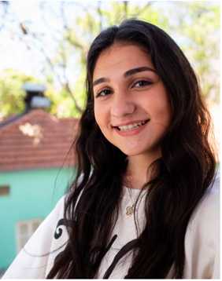
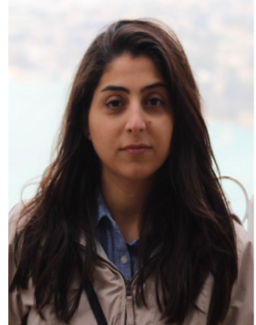
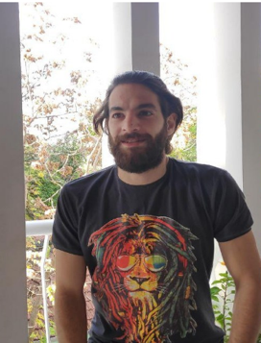
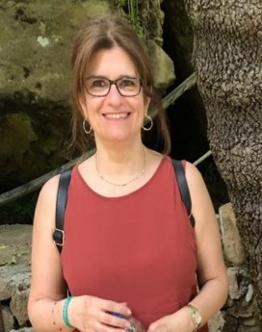
THE PRODUCTS & SERVICES TEAM
Samira Trawi
Narimane Ayoub
Hussein Lahham
Muriel Albina
Developer, trainer and THE key element of LAL
Old timer, developer and trainer. A true LAL expert
Our IT Magician
Pedagogical coach and Content virtuoso

Slide 47
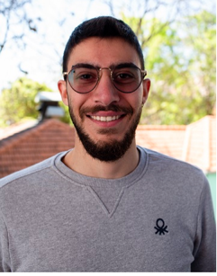
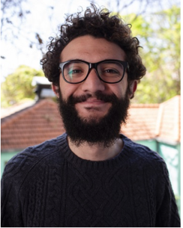
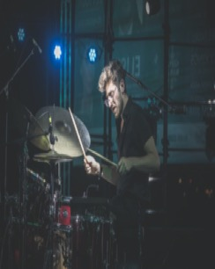
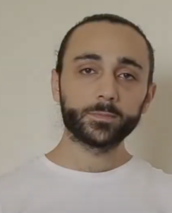
THE PRODUCTS & SERVICES TEAM
Yorgui Beylouni
Patrick Habib
Abdo Sawma
Fahd Al Jurdi
A creative mind, a skilled illustrator, and dear friend
Our products and services guru
If you need mind boggling and captivating animations, Abdo is your guy!
Arabic developer in the past, French developer in the future.

Slide 48
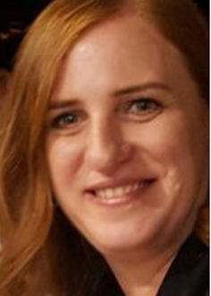
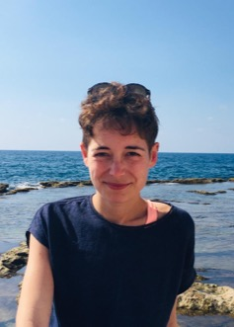
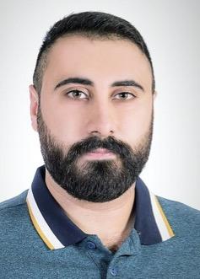
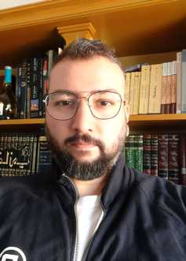
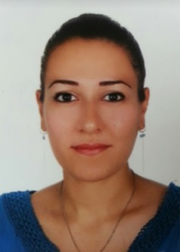
THE PRODUCTS & SERVICES TEAM
Hala El Chacar
Ines Collot
Ahmad Shaiban
Elie Assaker
Chantal Assaker
Master of language and translation with a keen eye for content editing and reviewing
French developer with a Lebanese spirit. The best combination!
Great project management skills and a great teacher
High quality content developer, voice over talent, and video editor. Basically high quality everything.
Thank you for sounding so good!

Slide 49
LESSONS LEARNED
CONTENT DEPARTMENT
Always listen first and adapt your solution to the needs.
Work closely with the teachers and make them the chore of the solution.
Set and follow standard operations procedure and management tools. They are essential for good governance, transparency and efficiency.
Trust the people because you need to trust them to make projects happen, and they need to be trusted to make projects happen.
Bridge between the learning in front of a screen and the direct environment of the students. The house can be a great lab.
Link learning to happiness.

Slide 50
LESSONS LEARNED
PRODUCTS & SERVICES DEPARTMENT
From the first year of our sustainability plan, this is what we learned from the Products & Services department:
Assess the needs of the target group before drafting anything
Assess the expectations and know what you can and cannot do
Motivate the team to be innovative instead of limiting them to specific tools and methods
Clear communication makes all the difference
Trust the team and the PM, we have awesome people on board!

Slide 51
LEARN AND UNLEARN
We learned a lot through these unprecedented times. We got wiser and better structured. This mix of unfortunate events (the COVID-19 pandemic, our collapsing socio-economic system, and our city that crumbled on its inhabitants as a result of the 4th of August Beirut port blast) was for us, like for many others, a time to rethink our priorities, to learn and unlearn, again and again.
However, the greatest lesson of all was given to us by the people who organized themselves in networks to help, working days and nights to support those whose houses and life were destroyed by the blast.
Even if confusedly known, it has become clear to us that no single educational initiative can provide a solution on its own. It's all about collaboration and forces working together. True, it is not always easy to work with others, to align visions, strategies and methodologies, to accept to listen to other opinions and take them into consideration. It is a whole adaptation process, which is often challenging, but when it succeeds, when you reach this point where you all work together toward the same goal, that is what can be called creating a better education for all. You experience this amazing feeling of hope; maybe there is still something to be done to save this country through educating the young.

Slide 52
FRIENDS AND PARTNERS
Support | Partners | Co-creation | Digital Transformation Services
BMZ/GIZ | INSPIRATION GARDEN | PRO-ABLED | MALAAK
MALALA FUND | ANA AQRA | WORLD VISION | BASMEH & ZEYTOONEH
EDUCATION ABOVE ALL | IRC | DIGNITY | JUSOOR
SAINT-GOBAIN | RIGHT TO PLAY |  | SOCIAL SUPPORT SOCIETY
RIGHT TO PLAY | DOT |  | RUWWAD AL TANMIYA
 | BOT |  | TAHADDI
 | IOF |  | BORDERLESS
 | FIWI |  | UNRWA

Slide 53
We look forward to an exceptional 2021 year
full of achievements, dreams, and more collaborations!

Slide 54
A SPECIAL THANKS TO:
The amazing team at GIZ:
  Ismael Nouns for his vision and engagement for a better Lebanon.
  Christel Safi for her vision and contagious positiveness and laugh.
  Ilona Mazloum for her unconditional help in building our procedures.
Caroline Hoy, Impact Evaluation and Monitoring Director at Queen Rania Foundation and her team, for listening to our needs and helping us building our own impact tools.
Fadi El Hage for his expert support in distance learning pedagogy
MIT SOLVE’s exceptional team .
Harvard Center for the Developing Child unconditional support.
Dorothy Gordon, Chairwoman, Information for All Programs at UNESCO, for her convictions and courage.
Nafez Dakkak from Queen Rania Foundation for his support through the MIT SOLVE project
Tariq Al Gurg from Dubaï Cares for his support and care through the MIT SOLVE Project

Slide 55




THANK YOU!
Click on the icons below to follow us

